Slide 1
0
13
The Molecular Basis of Inheritance
Notes:
*

Slide 2
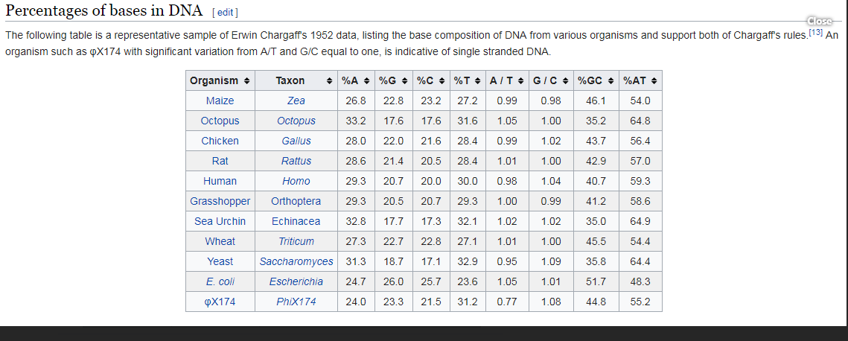

Slide 3
Overview: Life’s Operating Instructions
In 1953, James Watson and Francis Crick introduced an elegant double-helical model for the structure of deoxyribonucleic acid, or DNA
DNA, the substance of inheritance, is the most celebrated molecule of our time
Hereditary information is encoded in DNA and reproduced in all cells of the body (DNA replication)
Notes:
*

Slide 4
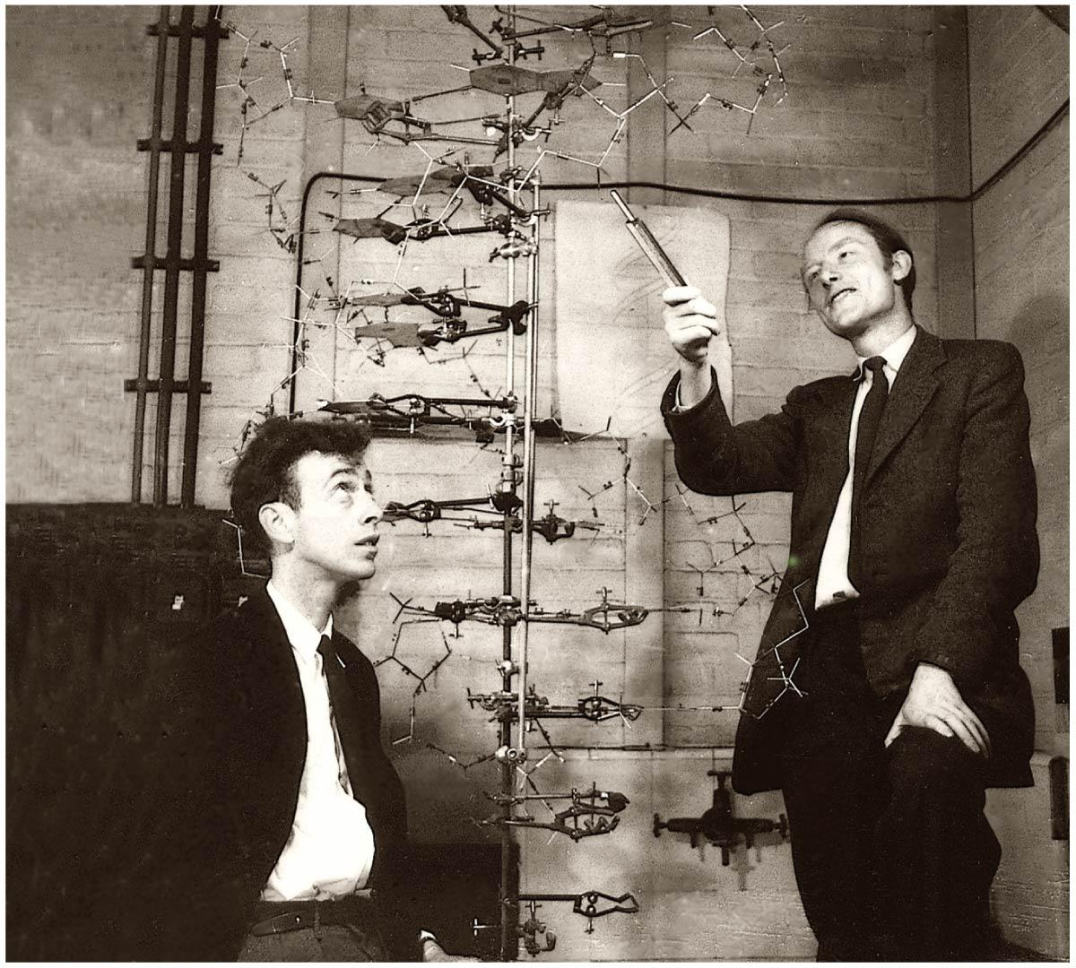
Figure 13.1
Notes:
*
Figure 13.1 How was the structure of DNA determined?

Slide 5
Concept 13.1: DNA is the genetic material
Early in the 20th century, the identification of the molecules of inheritance loomed as a major challenge to biologists
Notes:
*

Slide 6
The Search for the Genetic Material: Scientific Inquiry
When T. H. Morgan’s group showed that genes are located on chromosomes, the two components of chromosomes—DNA and protein—became candidates for the genetic material
The key factor in determining the genetic material was choosing appropriate experimental organisms
The role of DNA in heredity was first discovered by studying bacteria and the viruses that infect them
Notes:
*

Slide 7
Evidence That DNA Can Transform Bacteria
The discovery of the genetic role of DNA began with research by Frederick Griffith in 1928
Griffith worked with two strains of a bacterium, one pathogenic and one harmless
Notes:
*

Slide 8
When he mixed heat-killed remains of the pathogenic strain with living cells of the harmless strain, some living cells became pathogenic
He called this phenomenon transformation, now defined as a change in genotype and phenotype due to assimilation of foreign DNA
Notes:
*

Slide 9
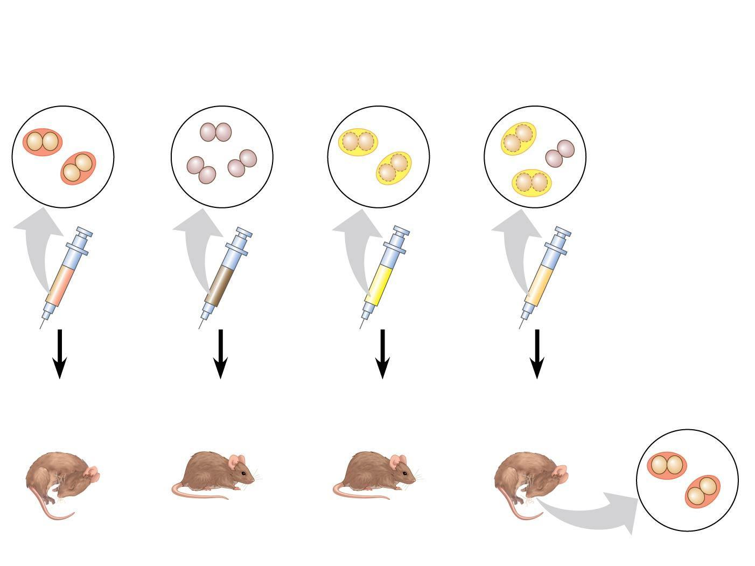
Figure 13.2
Experiment
Mixture of
heat-killed
S cells and
living R cells
Living
S cells
(control)
Living
R cells
(control)
Heat-killed
S cells
(control)
Results
Mouse dies
Mouse healthy
Mouse healthy
Mouse dies
Living S cells
Notes:
*
Figure 13.2 Inquiry: Can a genetic trait be transferred between different bacterial strains?

Slide 10
Later work by Oswald Avery and others identified the transforming substance as DNA
Many biologists remained skeptical, mainly because little was known about DNA and they thought proteins were better candidates for the genetic material
Notes:
*

Slide 11
Evidence That Viral DNA Can Program Cells
More evidence for DNA as the genetic material came from studies of viruses that infect bacteria
Such viruses, called bacteriophages (or phages), are widely used in molecular genetics research
A virus is DNA (or RNA) enclosed by a protective protein coat
Viruses must infect cells and take over the cells’ metabolic machinery in order to reproduce
Animation: Phage T2 Reproduction
Notes:
*

Slide 12
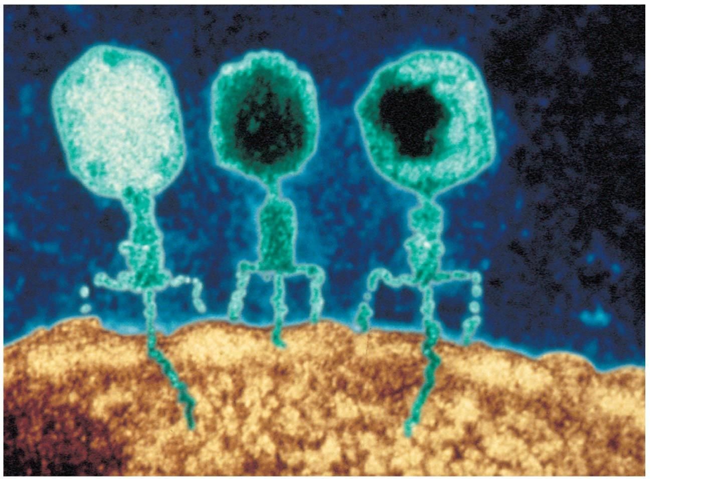
Figure 13.3
Phage
head
Tail
sheath
Tail fiber
DNA
100 nm
Bacterial
cell
Notes:
*
Figure 13.3 Viruses infecting a bacterial cell

Slide 13
In 1952, Alfred Hershey and Martha Chase showed that DNA is the genetic material of a phage known as T2
To determine this, they designed an experiment showing that only the DNA of the T2 phage, and not the protein, enters an E. coli cell during infection
They concluded that the injected DNA of the phage provides the genetic information
Animation: Hershey-Chase Experiment
Notes:
*

Slide 14
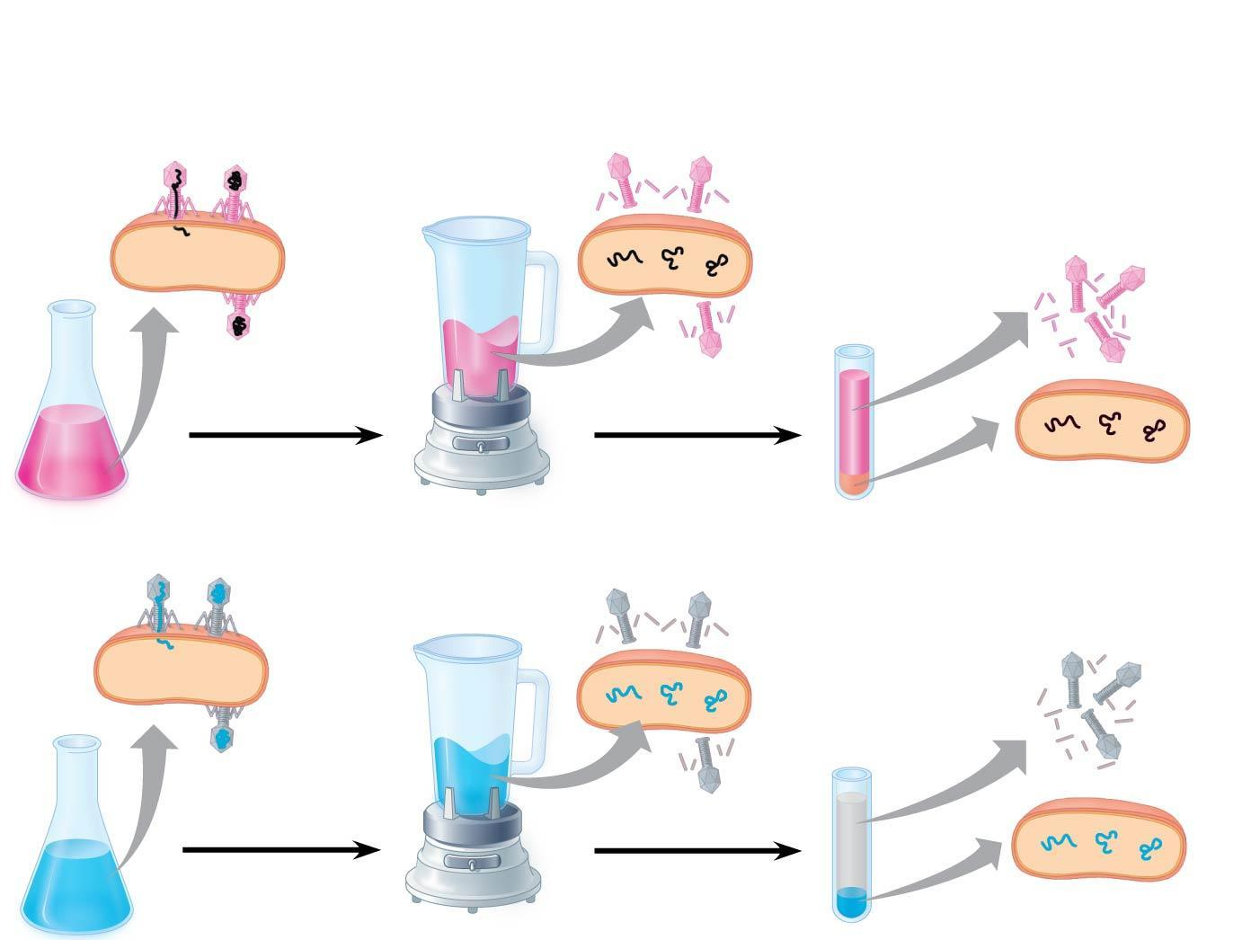
Figure 13.4
Experiment
Batch 1: Radioactive sulfur (³⁵S) in phage protein
1
Labeled phages
infect cells.
2
Agitation frees outside
phage parts from cells.
3
Centrifuged cells
form a pellet.
Radioactive
protein
4
Radioactivity
(phage protein)
found in liquid
Centrifuge
Batch 2: Radioactive phosphorus (³²P) in phage DNA
Pellet
Radioactive
DNA
Centrifuge
4
Radioactivity (phage
DNA) found in pellet
Pellet
Notes:
*
Figure 13.4 Inquiry: Is protein or DNA the genetic material of phage T2?

Slide 15
Additional Evidence That DNA Is the Genetic Material
It was known that DNA is a polymer of nucleotides, each consisting of a nitrogenous base, a sugar, and a phosphate group
In 1950, Erwin Chargaff reported that DNA composition varies from one species to the next
This evidence of diversity made DNA a more credible candidate for the genetic material
Animation: DNA and RNA Structure
Notes:
*

Slide 16
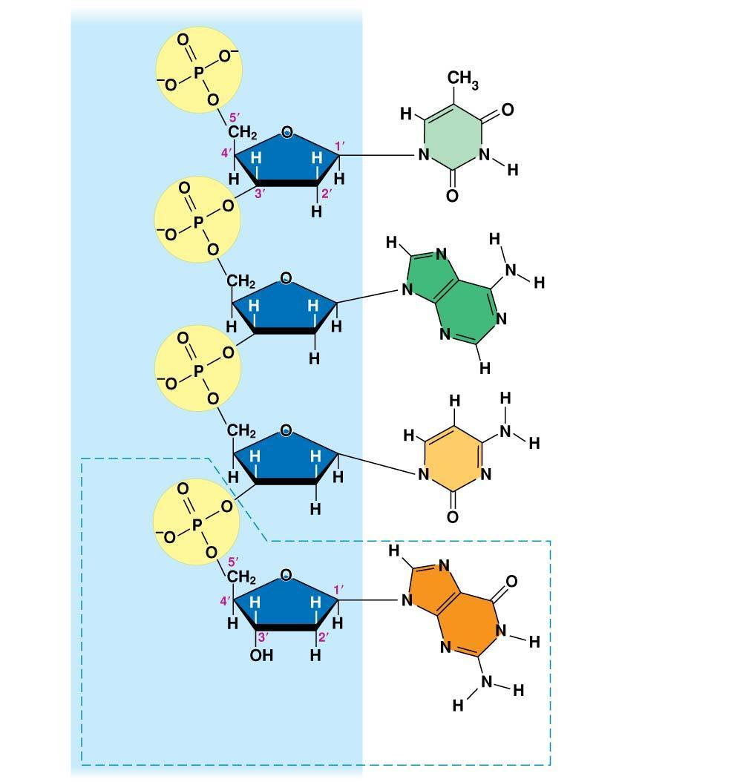
Figure 13.5
Sugar–
phosphate
backbone
Nitrogenous bases
5′ end
Thymine (T)
Adenine (A)
Cytosine (C)
3′ end
Guanine (G)
DNA
nucleotide
Notes:
*
Figure 13.5 The structure of a DNA strand

Slide 17
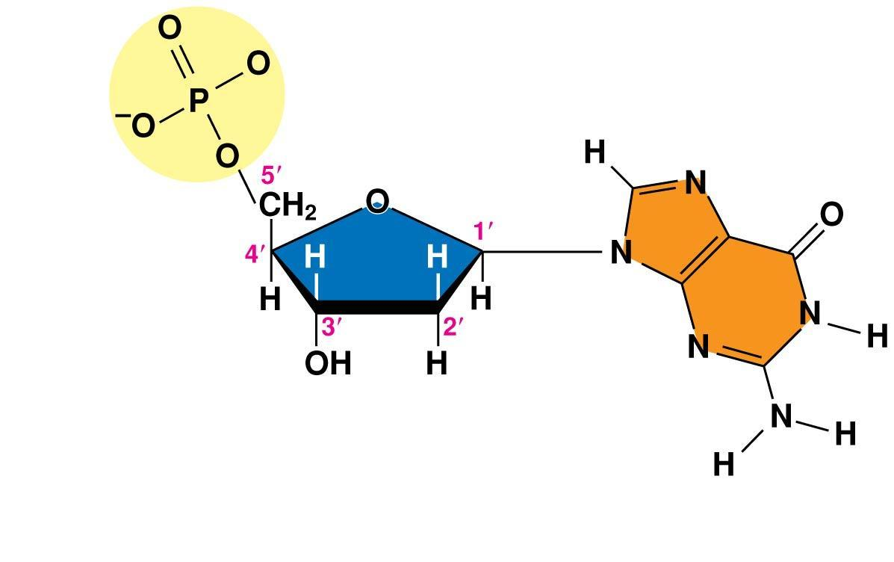
Figure 13.5a
Phosphate
3′ end
Sugar
(deoxyribose)
DNA
nucleotide
Nitrogenous
base
Notes:
*
Figure 13.5a The structure of a DNA strand (part 1: nucleotide)

Slide 18
Two findings became known as Chargaff’s rules
The base composition of DNA varies between species
In any species the number of A and T bases is equal and the number of G and C bases is equal
The basis for these rules was not understood until the discovery of the double helix
Notes:
*

Slide 19
Building a Structural Model of DNA: Scientific Inquiry
James Watson and Francis Crick were first to determine the structure of DNA
Maurice Wilkins and Rosalind Franklin were using a technique called X-ray crystallography to study molecular structure
Franklin produced a picture of the DNA molecule using this technique
Notes:
*

Slide 20
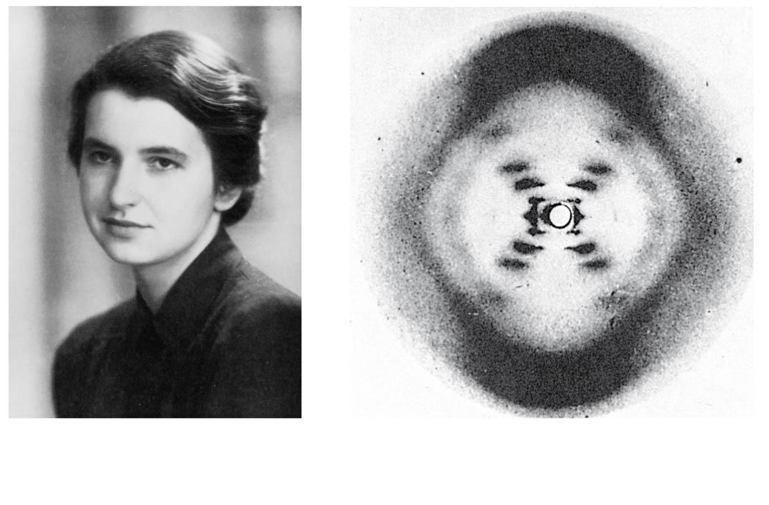
Figure 13.6
(a) Rosalind Franklin
(b) Franklin’s X-ray diffraction
photograph of DNA
Notes:
*
Figure 13.6 Rosalind Franklin and her X-ray diffraction photo of DNA

Slide 21
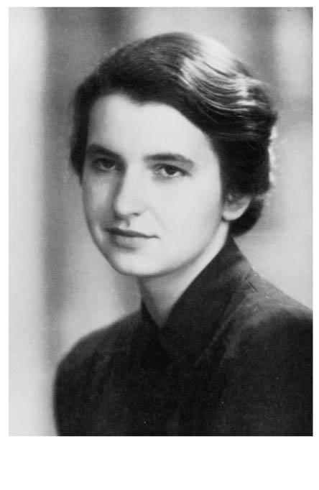
Figure 13.6a
(a) Rosalind Franklin
Notes:
*
Figure 13.6a Rosalind Franklin and her X-ray diffraction photo of DNA (part 1: Franklin)

Slide 22
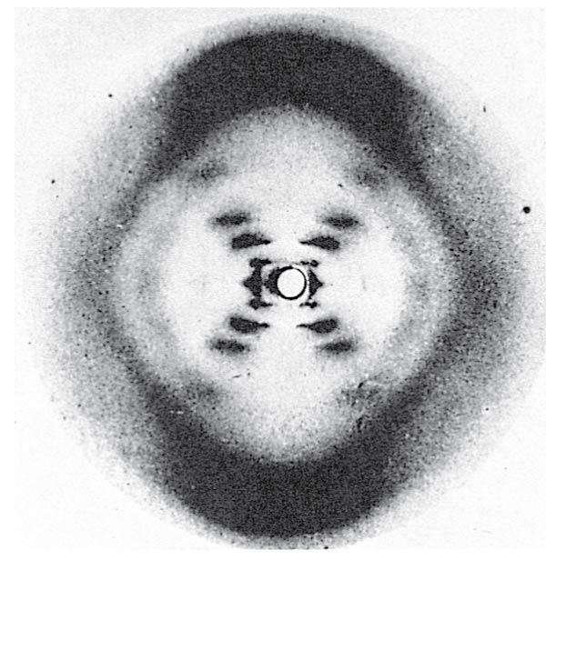
Figure 13.6b
(b) Franklin’s X-ray diffraction
photograph of DNA
Notes:
*
Figure 13.6b Rosalind Franklin and her X-ray diffraction photo of DNA (part 2: photo)

Slide 23
Franklin’s X-ray crystallographic images of DNA enabled Watson to deduce that DNA was helical
The X-ray images also enabled Watson to deduce the width of the helix and the spacing of the nitrogenous bases
The pattern in the photo suggested that the DNA molecule was made up of two strands, forming a double helix
Animation: DNA Double Helix
Video: DNA Surface Model
Notes:
*

Slide 24
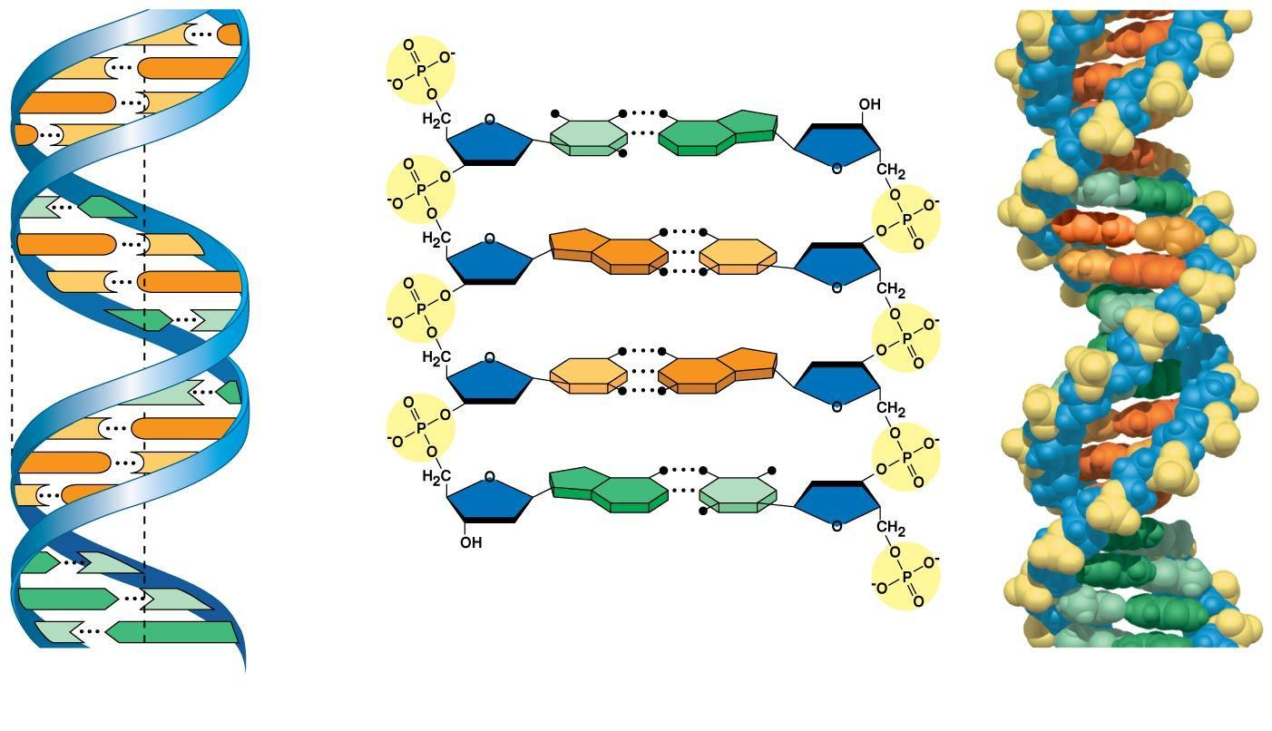
Figure 13.7
C
G
5′ end
C
G
Hydrogen bond
3′ end
G
C
G
C
T
A
3.4 nm
T
A
G
C
G
C
C
G
A
T
1 nm
C
G
T
A
C
G
G
C
C
G
A
T
A
T
3′ end
A
T
0.34 nm
T
A
5′ end
(a) Key features of
DNA structure
(b) Partial chemical structure
(c) Space-filling
model
Notes:
*
Figure 13.7 The double helix

Slide 25
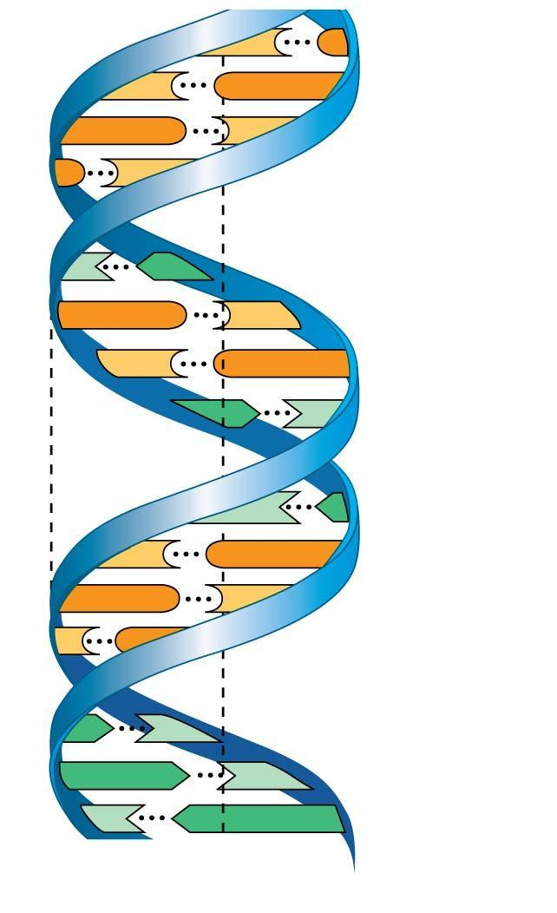
Figure 13.7a
C
G
C
G
G
C
G
C
3.4 nm
T
A
G
C
C
G
A
T
1 nm
T
A
C
G
G
C
C
G
A
T
A
T
0.34 nm
T
A
(a) Key features of DNA structure
Notes:
*
Figure 13.7a The double helix (part 1: key features)

Slide 26
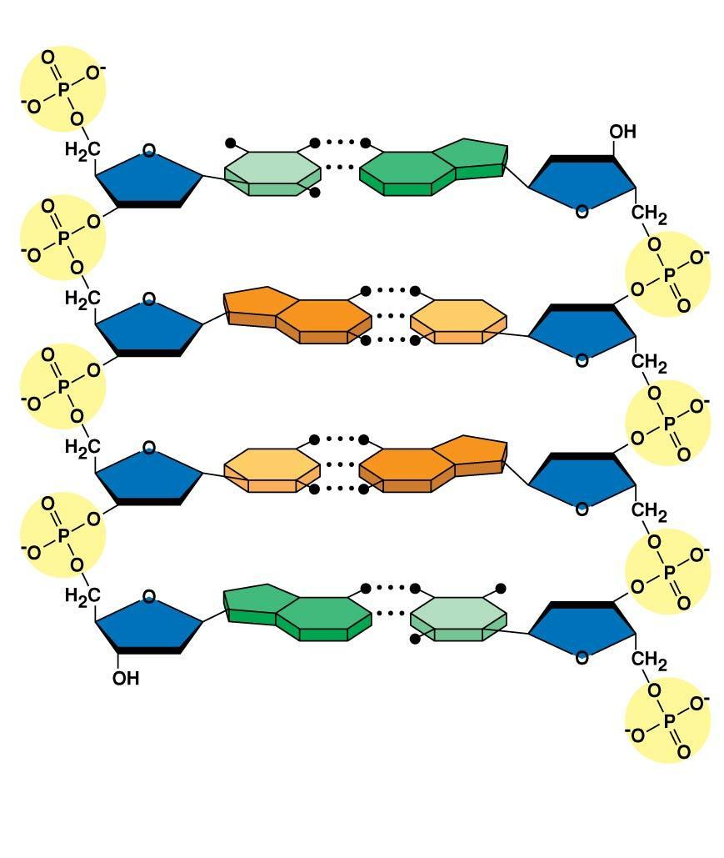
Figure 13.7b
5′ end
Hydrogen bond
3′ end
T
A
G
C
C
G
A
T
3′ end
5′ end
(b) Partial chemical structure
Notes:
*
Figure 13.7b The double helix (part 2: chemical structure)

Slide 27
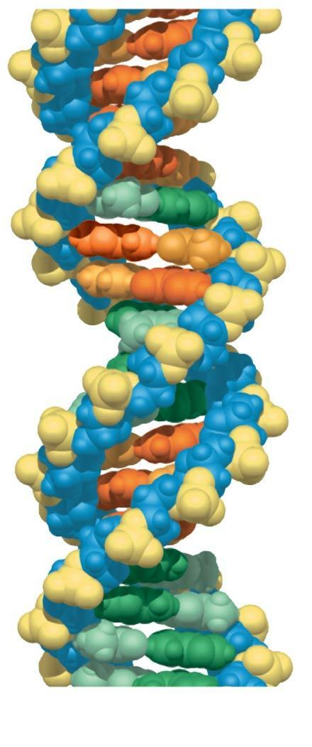
Figure 13.7c
(c) Space-filling model
Notes:
*
Figure 13.7c The double helix (part 3: space-filling model)

Slide 28
Watson and Crick built models of a double helix to conform to the X-ray measurements and the chemistry of DNA
Franklin had concluded that there were two outer sugar-phosphate backbones, with the nitrogenous bases paired in the molecule’s interior
Watson built a model in which the backbones were antiparallel (their subunits run in opposite directions)
Notes:
*

Slide 29
At first, Watson and Crick thought the bases paired like with like (A with A, and so on), but such pairings did not result in a uniform width
Instead, pairing a purine with a pyrimidine resulted in a uniform width consistent with the X-ray data
Notes:
*

Slide 30
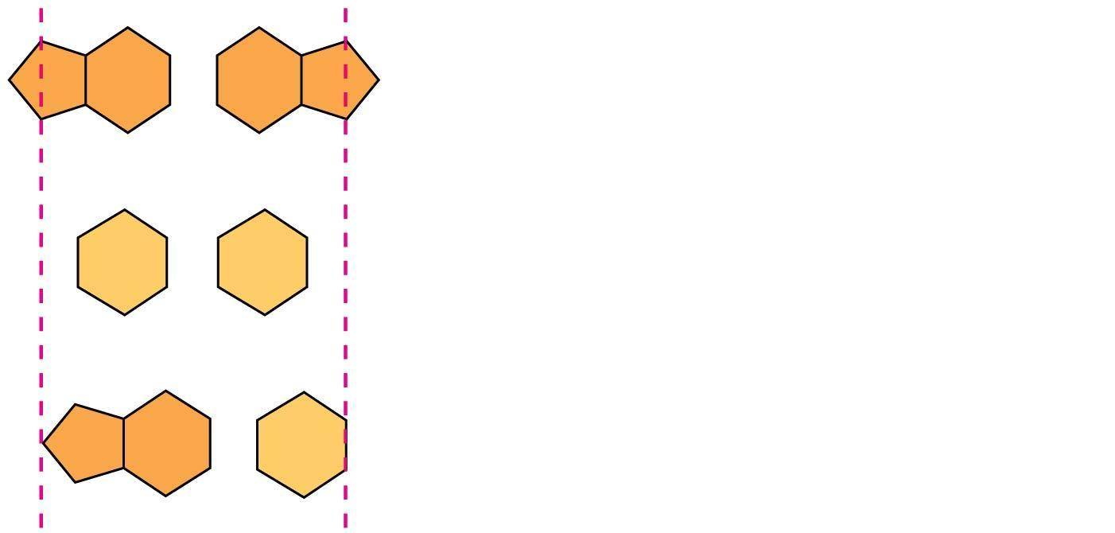
Figure 13.UN02
Purine + purine: too wide
Pyrimidine + pyrimidine: too narrow
Purine + pyrimidine: width
consistent with X-ray data
Notes:
*
Figure 13.UN02 In-text figure, purines and pyrimidines, p. 250

Slide 31
Watson and Crick reasoned that the pairing was more specific, dictated by the base structures
They determined that adenine (A) paired only with thymine (T), and guanine (G) paired only with cytosine (C)
The Watson-Crick model explains Chargaff’s rules: in any organism the amount of A = T, and the amount of G = C
Notes:
*

Slide 32
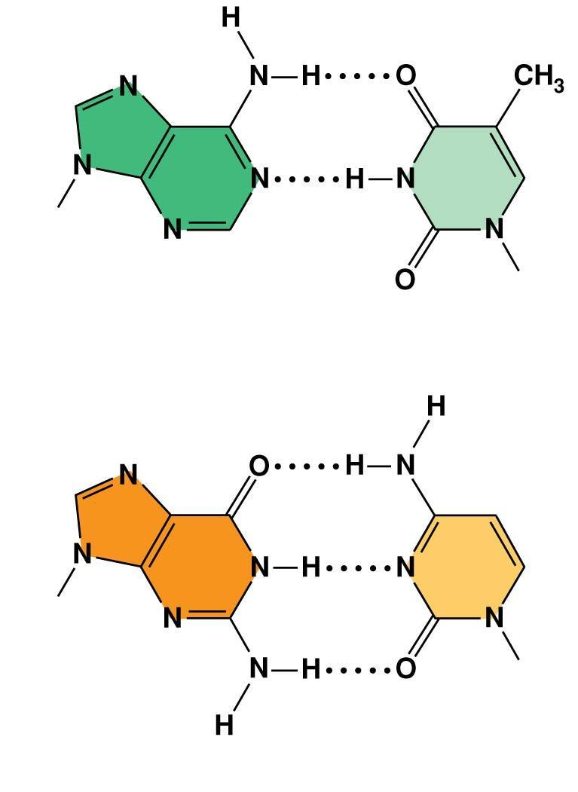
Figure 13.8
Sugar
Sugar
Adenine (A)
Thymine (T)
Sugar
Sugar
Guanine (G)
Cytosine (C)
Notes:
*
Figure 13.8 Base pairing in DNA

Slide 33
Concept 13.2: Many proteins work together in DNA replication and repair
The relationship between structure and function is manifest in the double helix
Watson and Crick noted that the specific base pairing suggested a possible copying mechanism for genetic material
Notes:
*

Slide 34
Figure 13.9-1
A
T
C
G
T
A
A
T
G
C
(a) Parental
molecule
Notes:
*
Figure 13.9-1 A model for DNA replication: the basic concept (step 1)

Slide 35
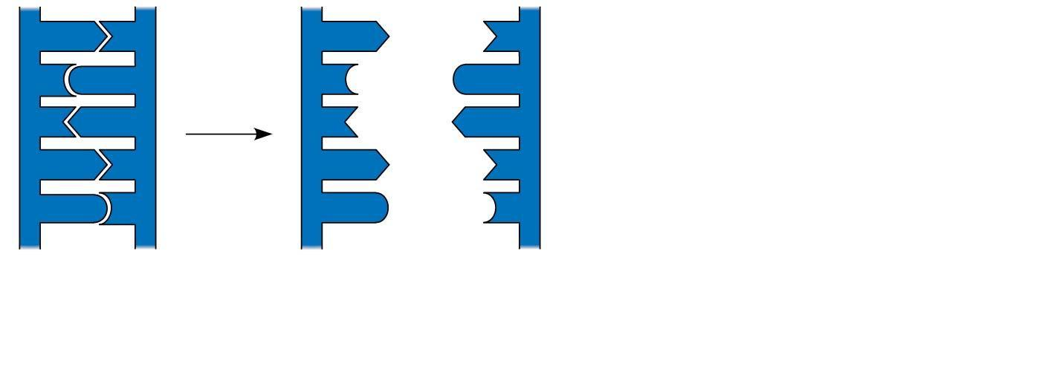
Figure 13.9-2
A
T
A
T
C
G
C
G
T
A
T
A
A
T
A
T
G
C
G
C
(a) Parental
molecule
(b) Separation of parental
strands into templates
Notes:
*
Figure 13.9-2 A model for DNA replication: the basic concept (step 2)

Slide 36
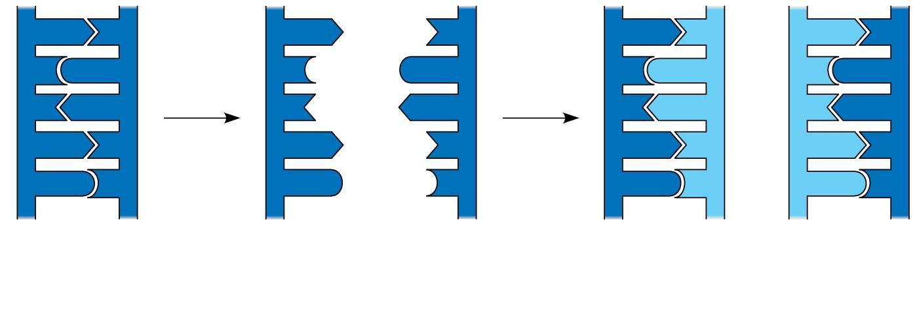
Figure 13.9-3
A
T
A
T
A
T
A
T
C
G
C
G
C
G
C
G
T
A
T
A
T
A
T
A
A
T
A
T
A
T
A
T
G
C
G
C
G
C
G
C
(a) Parental
molecule
(b) Separation of parental
strands into templates
(c) Formation of new
strands complementary
to template strands
Notes:
*
Figure 13.9-3 A model for DNA replication: the basic concept (step 3)

Slide 37
The Basic Principle: Base Pairing to a Template Strand
Since the two strands of DNA are complementary, each strand acts as a template for building a new strand in replication
In DNA replication, the parent molecule unwinds, and two new daughter strands are built based on base-pairing rules
Notes:
*

Slide 38
Watson and Crick’s semiconservative model of replication predicts that when a double helix replicates, each daughter molecule will have one old strand (derived or “conserved” from the parent molecule) and one newly made strand
Competing models were the conservative model (the two parent strands rejoin) and the dispersive model (each strand is a mix of old and new)
Notes:
*

Slide 39
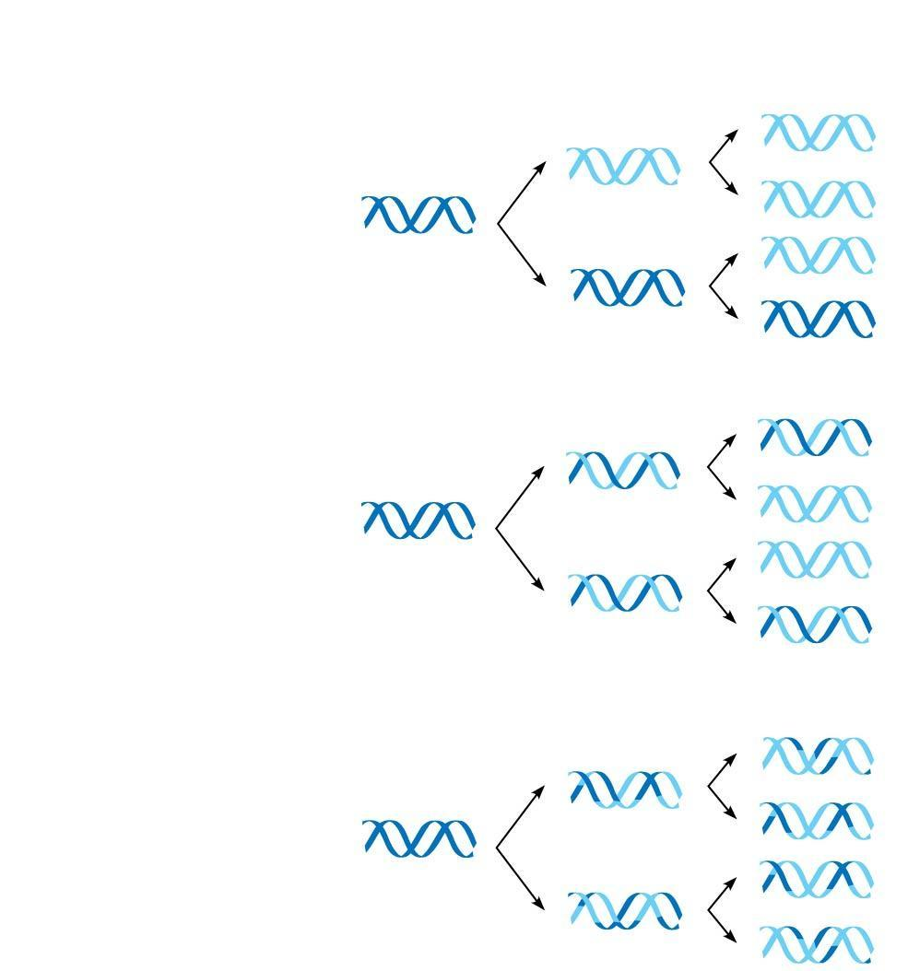
Figure 13.10
First
replication
Second
replication
Parent cell
(a) Conservative
model
(b) Semiconservative
model
(c) Dispersive
model
Notes:
*
Figure 13.10 Three alternative models of DNA replication

Slide 40
Experiments by Matthew Meselson and Franklin Stahl supported the semiconservative model
Notes:
*

Slide 41
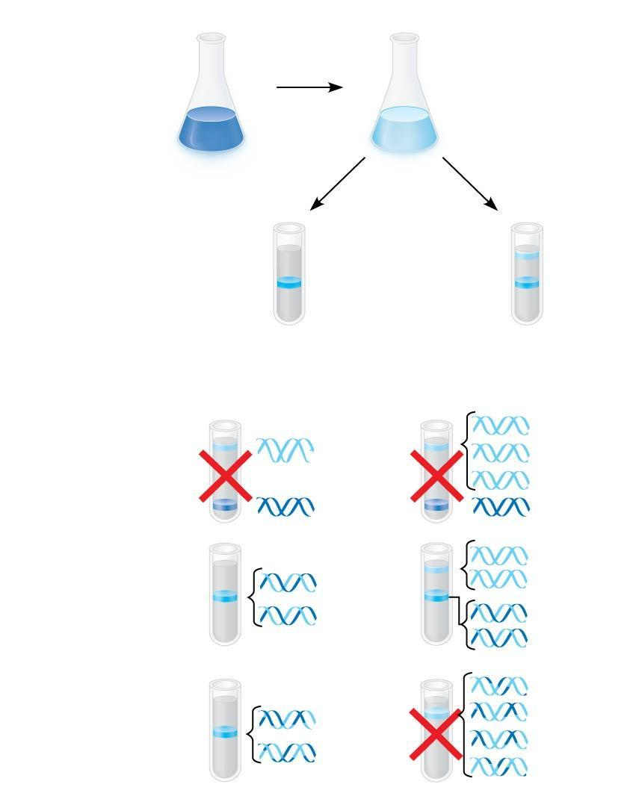
Figure 13.11
Experiment
1
Bacteria
cultured in
medium
with ¹⁵N
(heavy
isotope)
2
Bacteria
transferred
to medium
with ¹⁴N
(lighter
isotope)
Results
3
DNA sample
centrifuged
after first
replication
4
DNA sample
centrifuged
after second
replication
Less
dense
More
dense
Conclusion
Predictions:
First replication
Second replication
Conservative
model
Semiconservative
model
Dispersive
model
Notes:
*
Figure 13.11 Inquiry: Does DNA replication follow the conservative, semiconservative, or dispersive model?

Slide 42
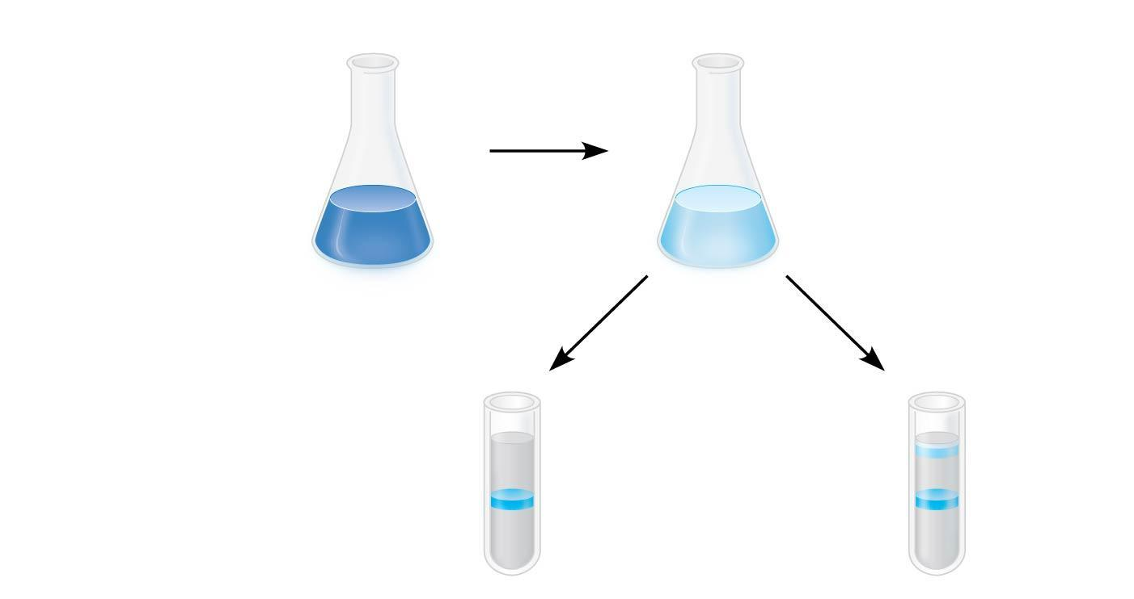
Figure 13.11a
Experiment
1
Bacteria
cultured in
medium
with ¹⁵N
(heavy
isotope)
2
Bacteria
transferred
to medium
with ¹⁴N
(lighter
isotope)
Results
DNA sample
centrifuged
after first
replication
Less
dense
3
4
DNA sample
centrifuged
after second
replication
More
dense
Notes:
*
Figure 13.11a Inquiry: Does DNA replication follow the conservative, semiconservative, or dispersive model? (part 1: experiment and results)

Slide 43
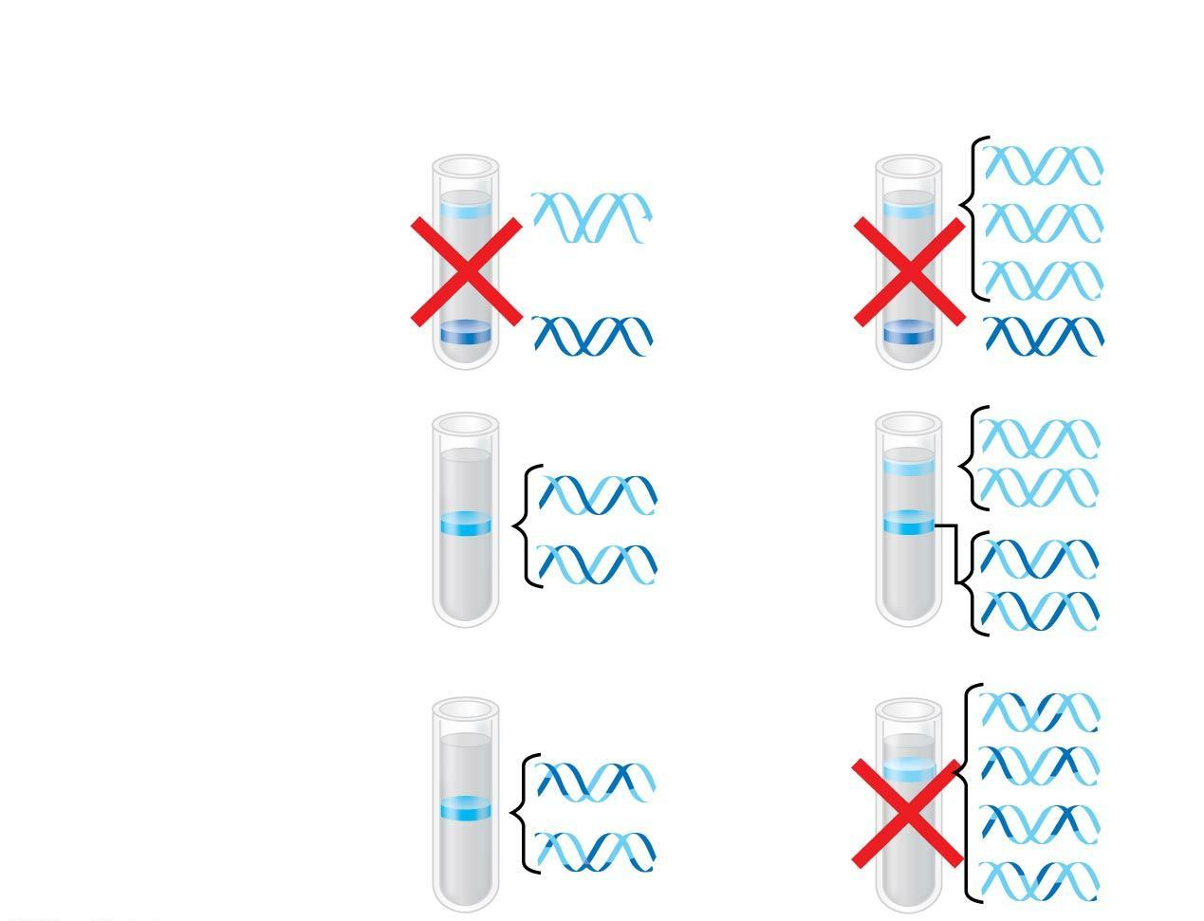
Figure 13.11b
Conclusion
Predictions:
First replication
Second replication
Conservative
model
Semiconservative
model
Dispersive
model
Notes:
*
Figure 13.11b Inquiry: Does DNA replication follow the conservative, semiconservative, or dispersive model? (part 2: conclusions)

Slide 44
DNA Replication: A Closer Look
The copying of DNA is remarkable in its speed and accuracy
More than a dozen enzymes and other proteins participate in DNA replication
Much more is known about how this “replication machine” works in bacteria than in eukaryotes
Most of the process is similar between prokaryotes and eukaryotes
Notes:
*

Slide 45
Getting Started
Replication begins at particular sites called origins of replication, where the two DNA strands are separated, opening up a replication “bubble”
At each end of a bubble is a replication fork, a Y-shaped region where the parental strands of DNA are being unwound
Animation: DNA Replication Overview
Animation: Origins of Replication
Notes:
*

Slide 46
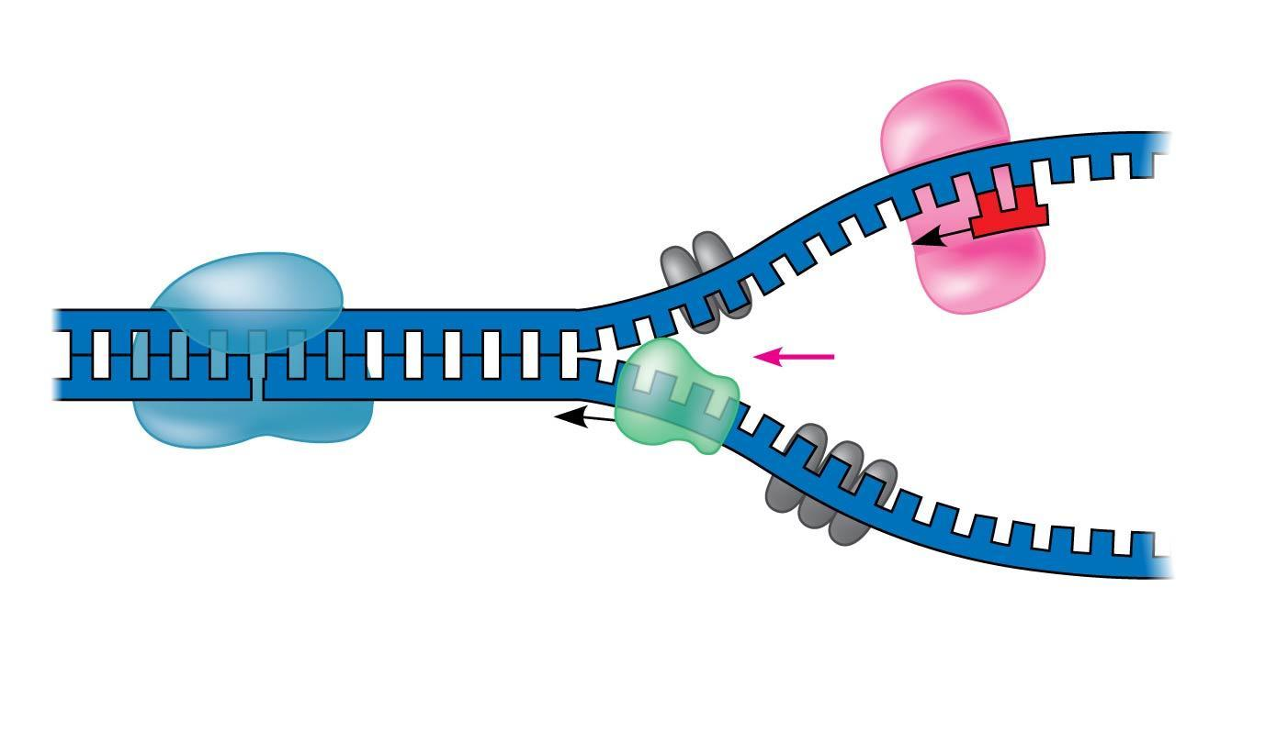
Figure 13.12
Primase
Topoisomerase
3′
5′
RNA
primer
3′
5′
Replication
fork
3′
Helicase
5′
Single-strand binding
proteins
Notes:
*
Figure 13.12 Some of the proteins involved in the initiation of DNA replication

Slide 47
Helicases are enzymes that untwist the double helix at the replication forks
Single-strand binding proteins bind to and stabilize single-stranded DNA
Topoisomerase relieves the strain caused by tight twisting ahead of the replication fork by breaking, swiveling, and rejoining DNA strands
Notes:
*

Slide 48
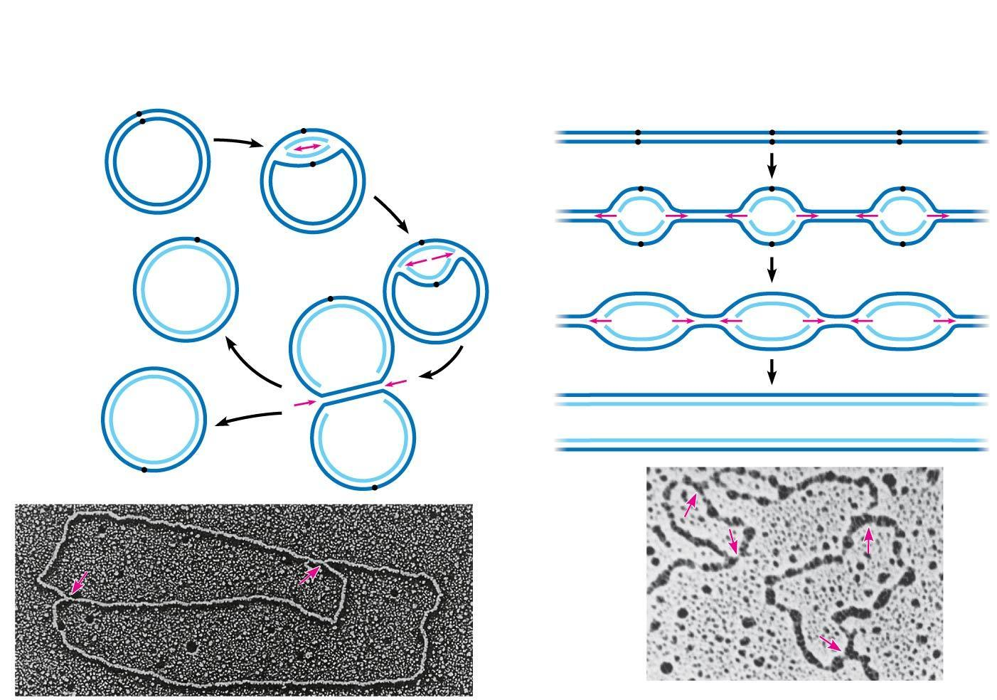
Figure 13.13
(a) Origin of replication in an E. coli cell
(b) Origins of replication in a eukaryotic
cell
Origin of
replication
Parental
(template) strand
Origin of
replication
Double-stranded
DNA molecule
Daughter
(new) strand
Parental (template)
strand
Daughter (new)
strand
Replication
fork
Double-
stranded
DNA
molecule
Replication
bubble
Replication fork
Bubble
Two
daughter DNA
molecules
Two daughter DNA molecules
0.5 μm
0.25 μm
Notes:
*
Figure 13.13 Origins of replication in E. coli and eukaryotes

Slide 49
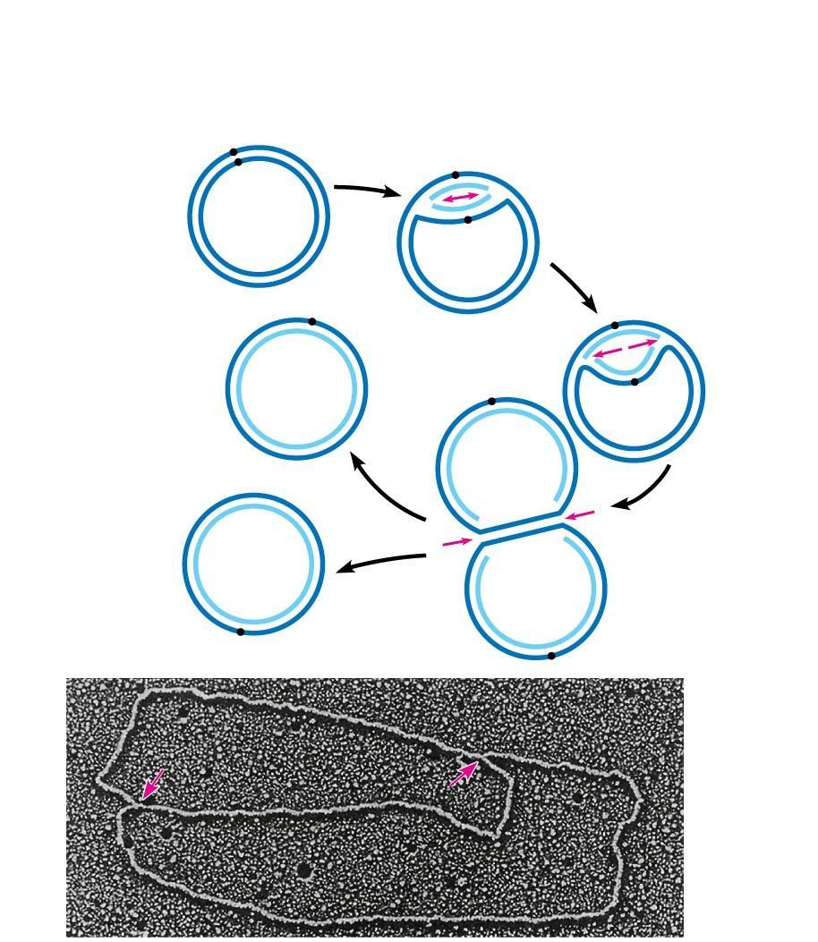
Figure 13.13a
(a) Origin of replication in an E. coli cell
Origin of
replication
Parental
(template) strand
Daughter
(new) strand
Double-
stranded
DNA
molecule
Replication
fork
Replication
bubble
Two
daughter DNA
molecules
0.5 μm
Notes:
*
Figure 13.13a Origins of replication in E. coli and eukaryotes (part 1: E. coli)

Slide 50
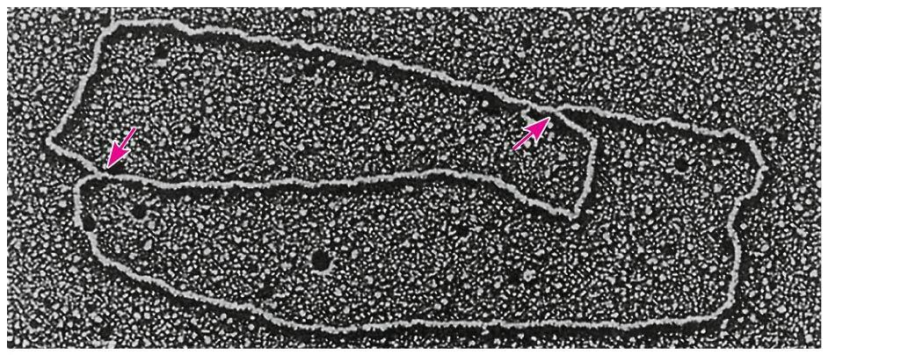
Figure 13.13aa
0.5 μm
Notes:
*
Figure 13.13aa Origins of replication in E. coli and eukaryotes (part 1a: E. coli, TEM)

Slide 51
Multiple replication bubbles form and eventually fuse, speeding up the copying of DNA
Notes:
*

Slide 52
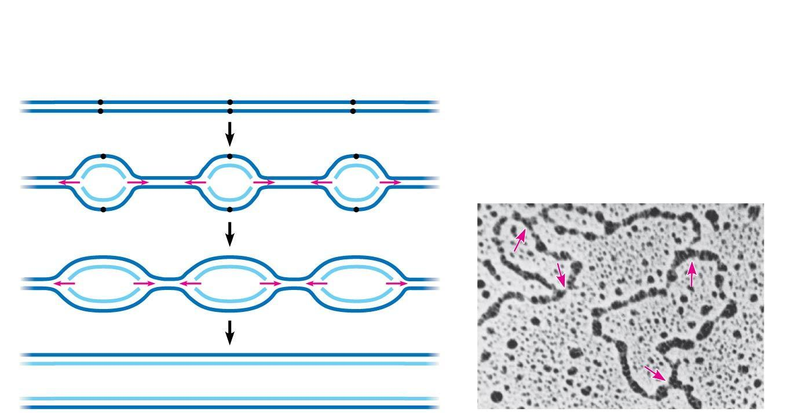
Figure 13.13b
(b) Origins of replication in a eukaryotic cell
Origin of
replication
Double-stranded
DNA molecule
Parental (template)
strand
Daughter (new)
strand
Bubble
Replication fork
0.25 μm
Two daughter DNA molecules
Notes:
*
Figure 13.13b Origins of replication in E. coli and eukaryotes (part 2: eukaryotes)

Slide 53
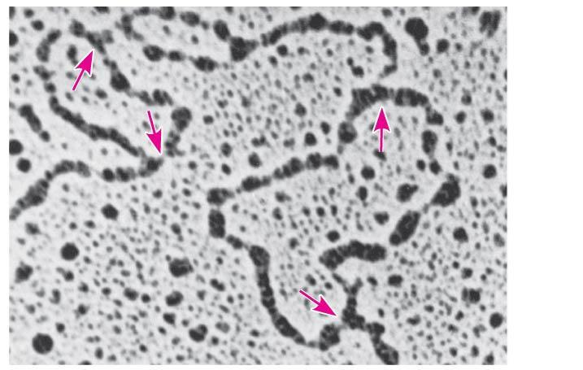
Figure 13.13ba
0.25 μm
Notes:
*
Figure 13.13ba Origins of replication in E. coli and eukaryotes (part 2a: eukaryotes, TEM)

Slide 54
Synthesizing a New DNA Strand
DNA polymerases cannot initiate synthesis of a polynucleotide; they can only add nucleotides to an already existing chain base-paired with the template
The initial nucleotide strand is a short RNA primer
Notes:
*

Slide 55
The enzyme, primase, starts an RNA chain from a single RNA nucleotide and adds RNA nucleotides one at a time using the parental DNA as a template
The primer is short (5–10 nucleotides long)
The new DNA strand will start from the 3′ end of the RNA primer
Notes:
*

Slide 56
Enzymes called DNA polymerases catalyze the elongation of new DNA at a replication fork
Most DNA polymerases require a primer and a DNA template strand
The rate of elongation is about 500 nucleotides per second in bacteria and 50 per second in human cells
Notes:
*

Slide 57
Each nucleotide that is added to a growing DNA consists of a sugar attached to a base and three phosphate groups
dATP is used to make DNA and is similar to the ATP of energy metabolism
The difference is in the sugars: dATP has deoxyribose, while ATP has ribose
As each monomer nucleotide joins the DNA strand, it loses two phosphate groups as a molecule of pyrophosphate
Notes:
*

Slide 58
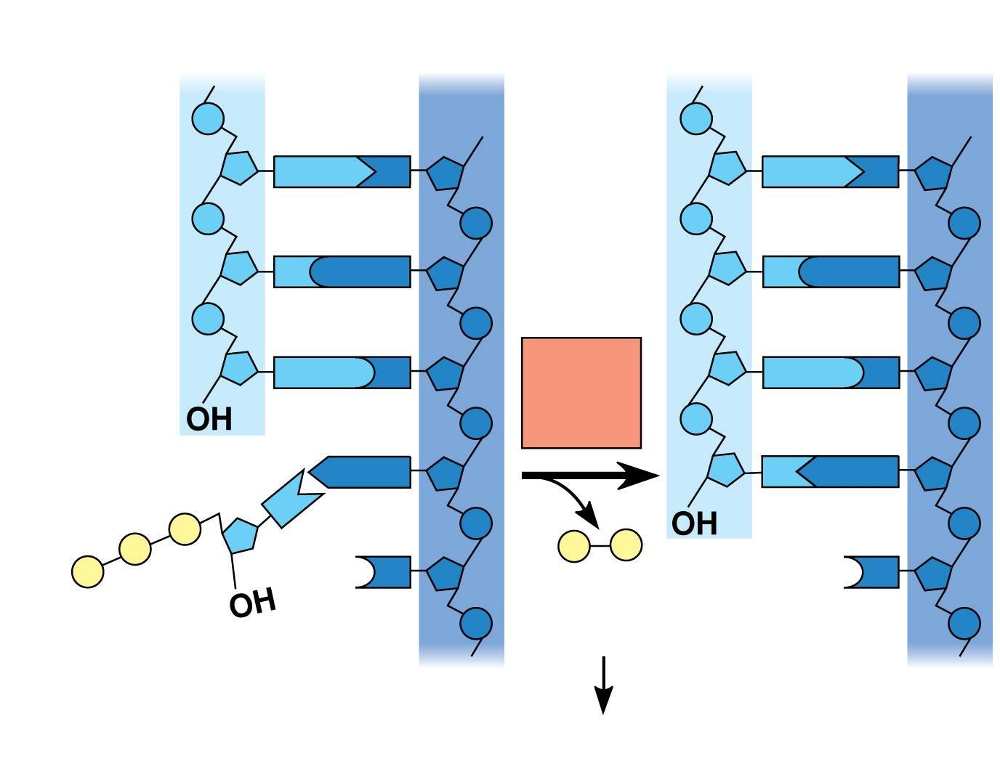
Figure 13.14
New strand
Template strand
5′
3′
5′
3′
Sugar
A
T
A
T
Phosphate
Base
C
G
C
G
G
C
DNA
poly-
merase
G
C
3′
A
T
A
T
P
P
P
P
i
P
C
3′
C
Pyro-
phosphate
Nucleotide
5′
5′
2
P
i
Notes:
*
Figure 13.14 Addition of a nucleotide to a DNA strand

Slide 59
Antiparallel Elongation
The antiparallel structure of the double helix affects replication
DNA polymerases add nucleotides only to the free 3′ end of a growing strand; therefore, a new DNA strand can elongate only in the 5′ to 3′ direction
Notes:
*

Slide 60
Along one template strand of DNA, the DNA polymerase synthesizes a leading strand continuously, moving toward the replication fork
Animation: Leading Strand
Notes:
*

Slide 61
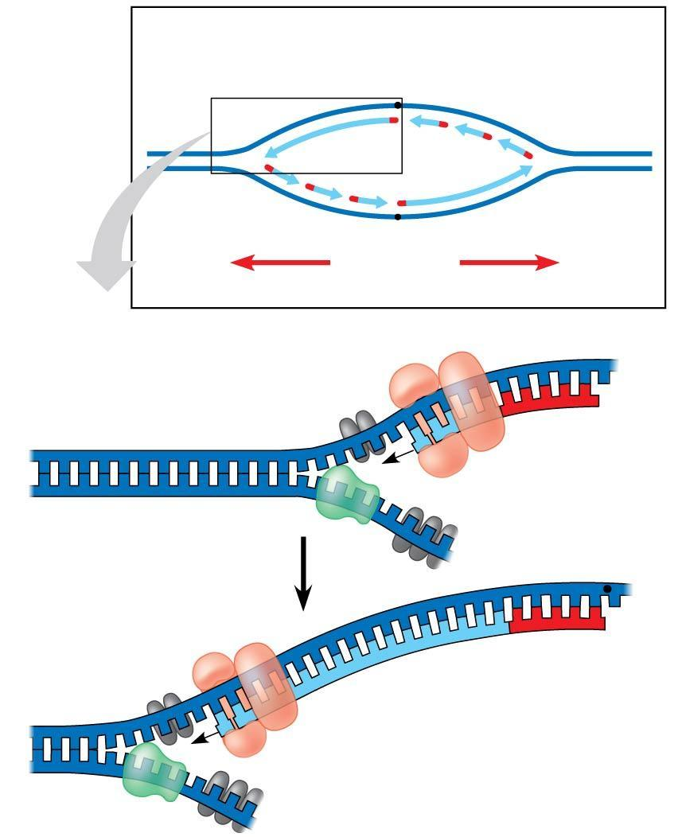
Figure 13.15
Overview
Leading
strand
Origin of replication
Lagging
strand
Primer
Leading
strand
Lagging strand
Overall
directions
of replication
Origin of replication
3′
5′
5′
RNA primer
3′
Sliding clamp
3′
Parental DNA
DNA pol III
5′
3′
5′
5′
Continuous elongation
in the 5′ to 3′ direction
3′
3′
5′
Notes:
*
Figure 13.15 Synthesis of the leading strand during DNA replication

Slide 62
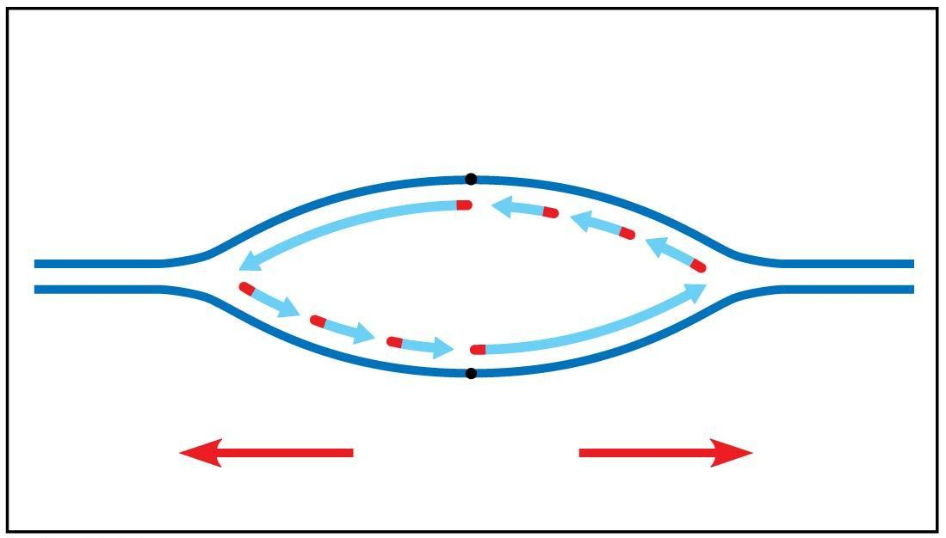
Figure 13.15a
Overview
Leading
strand
Origin of replication
Lagging
strand
Primer
Leading
strand
Lagging strand
Overall
directions
of replication
Notes:
*
Figure 13.15a Synthesis of the leading strand during DNA replication (part 1)

Slide 63
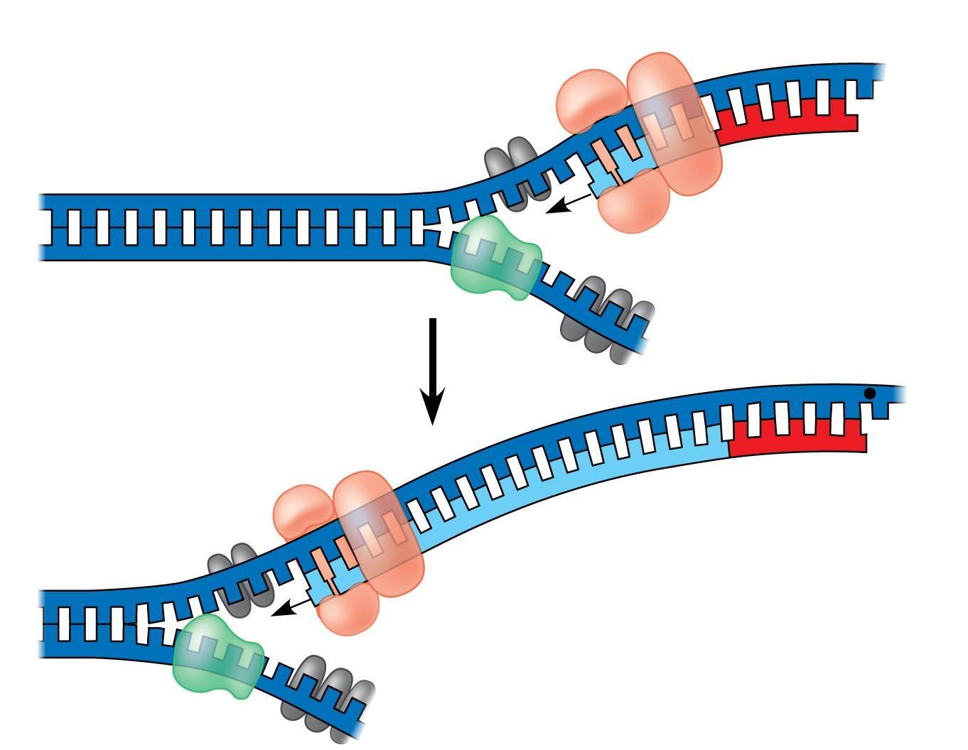
Figure 13.15b
Origin of replication
3′
5′
5′
RNA primer
3′
3′
Sliding clamp
Parental DNA
DNA pol III
5′
3′
5′
5′
Continuous elongation
in the 5′ to 3′ direction
3′
3′
5′
Notes:
*
Figure 13.15b Synthesis of the leading strand during DNA replication (part 2)

Slide 64
To elongate the other new strand, called the lagging strand, DNA polymerase must work in the direction away from the replication fork
The lagging strand is synthesized as a series of segments called Okazaki fragments
Notes:
*

Slide 65
After formation of Okazaki fragments, DNA polymerase I removes the RNA primers and replaces the nucleotides with DNA
The remaining gaps are joined together by DNA ligase
Animation: Lagging Strand
Animation: DNA Replication Review
Notes:
*

Slide 66
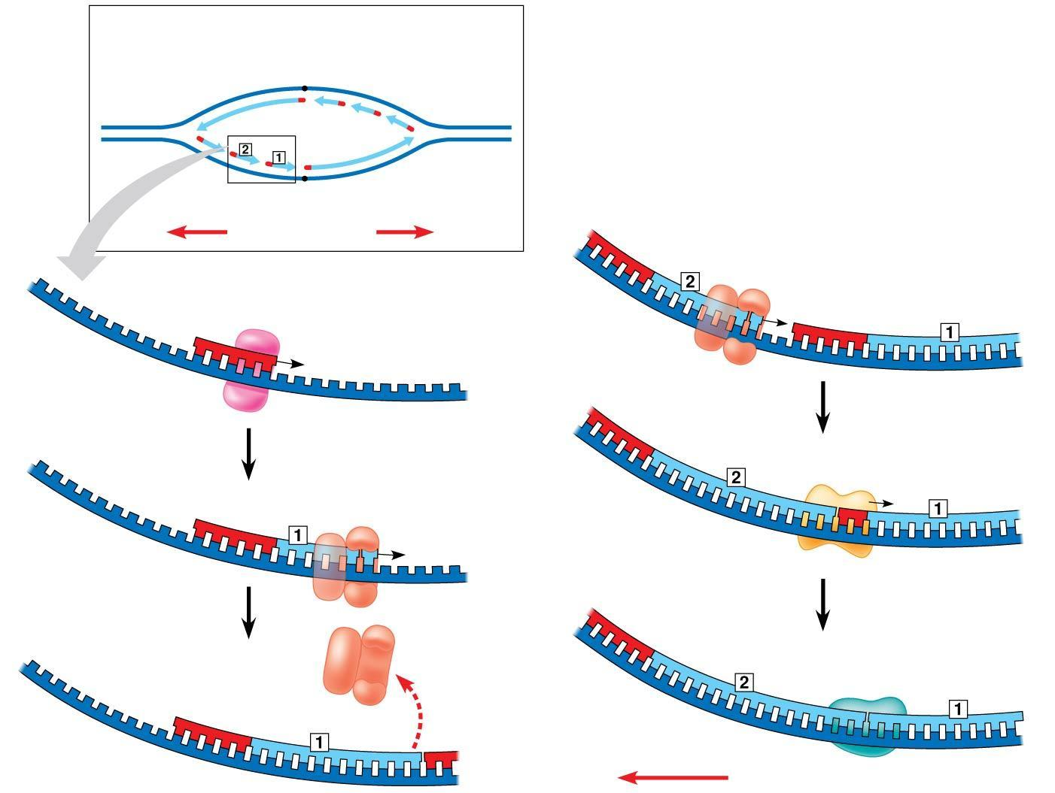
Figure 13.16
Overview
Lagging
strand
Origin of replication
Leading
strand
Lagging
strand
Leading
strand
RNA primer
for fragment 2
Overall directions
of replication
Okazaki
fragment 2
5′
4
DNA pol III
makes Okazaki
fragment 2.
3′
3′
1
Primase makes
RNA primer.
5′
3′
3′
Template
strand
5′
5′
5′
5
DNA pol I
replaces RNA
with DNA.
3′
RNA primer
for fragment 1
2
DNA pol III
makes Okazaki
fragment 1.
3′
5′
3′
3′
5′
5′
6
DNA ligase forms
bonds between
DNA fragments.
5′
3′
3
DNA pol III
detaches.
3′
Okazaki
fragment 1
5′
3′
3′
5′
5′
Overall direction of replication
Notes:
*
Figure 13.16 Synthesis of the lagging strand

Slide 67
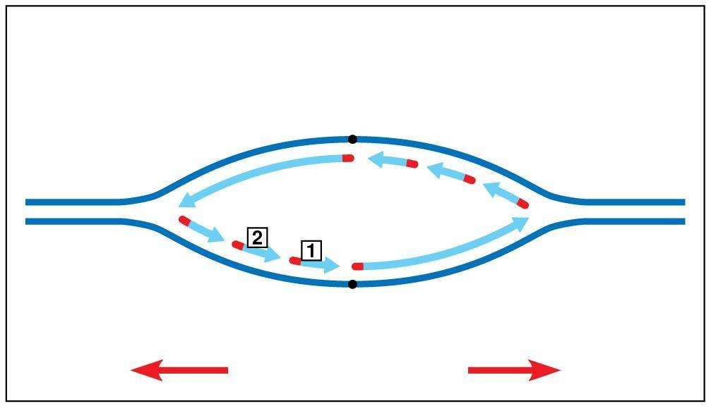
Figure 13.16a
Overview
Lagging
strand
Origin of replication
Leading
strand
Lagging
strand
Leading
strand
Overall directions
of replication
Notes:
*
Figure 13.16a Synthesis of the lagging strand (part 1)

Slide 68
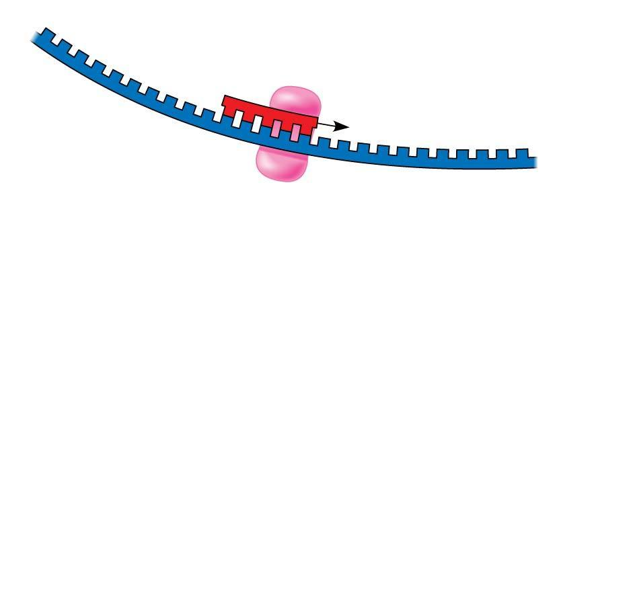
Figure 13.16b-1
3′
1
Primase makes
RNA primer.
5′
3′
Template
strand
5′
Notes:
*
Figure 13.16b-1 Synthesis of the lagging strand (part 2, step 1)

Slide 69
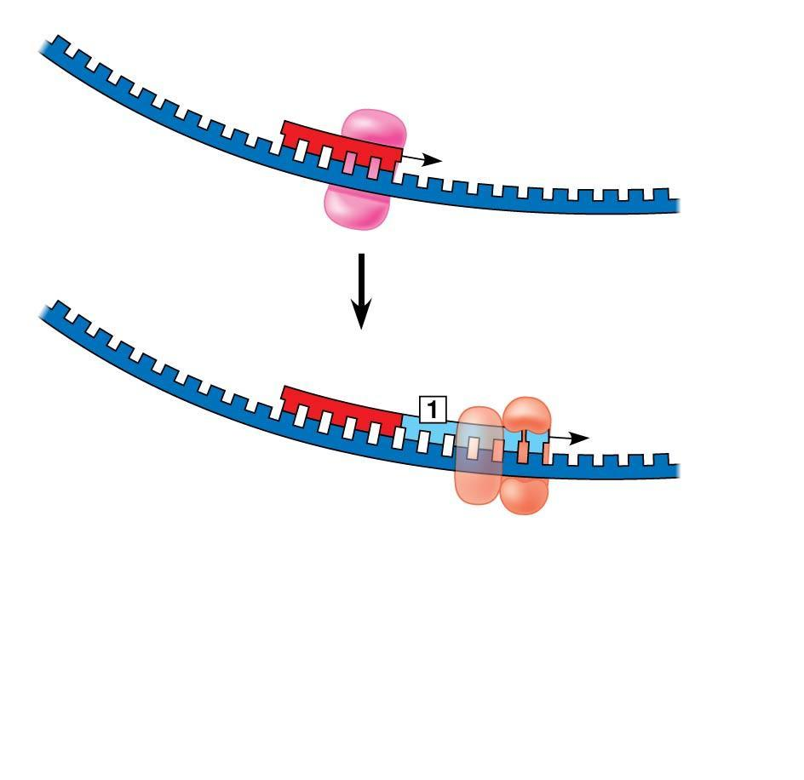
Figure 13.16b-2
3′
1
Primase makes
RNA primer.
5′
3′
Template
strand
5′
RNA primer
for fragment 1
2
DNA pol III
makes Okazaki
fragment 1.
3′
5′
3′
5′
Notes:
*
Figure 13.16b-2 Synthesis of the lagging strand (part 2, step 2)

Slide 70
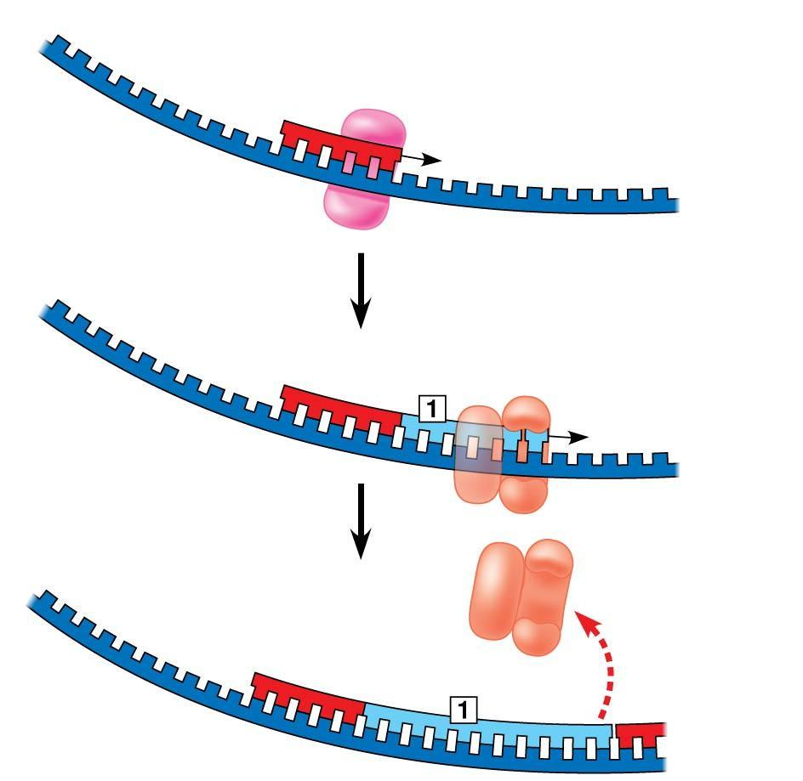
Figure 13.16b-3
3′
1
Primase makes
RNA primer.
5′
3′
Template
strand
5′
RNA primer
for fragment 1
2
DNA pol III
makes Okazaki
fragment 1.
3′
5′
3′
5′
3
DNA pol III
detaches.
3′
Okazaki
fragment 1
5′
3′
5′
Notes:
*
Figure 13.16b-3 Synthesis of the lagging strand (part 2, step 3)

Slide 71
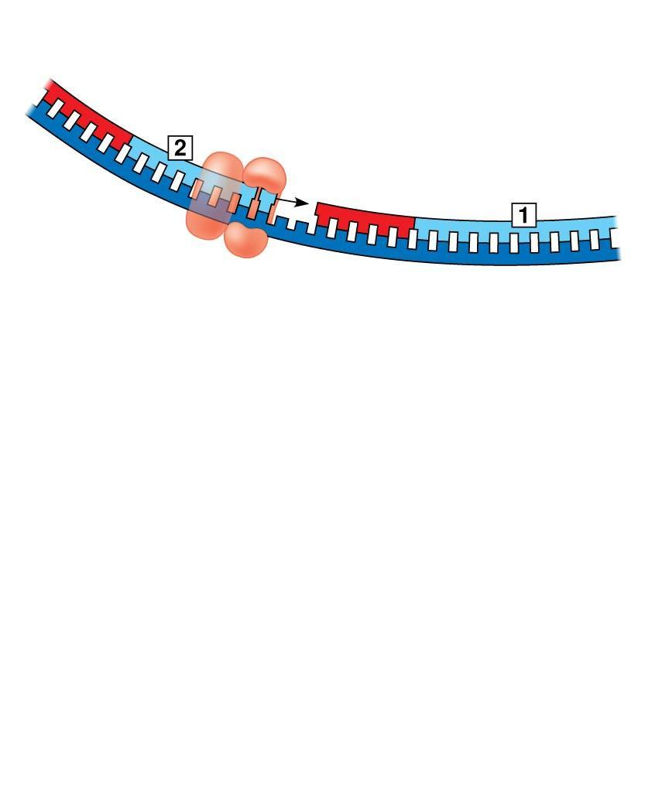
Figure 13.16c-1
RNA primer for fragment 2
5′
Okazaki
fragment 2
3′
4
DNA pol III
makes Okazaki
fragment 2.
3′
5′
Notes:
*
Figure 13.16c-1 Synthesis of the lagging strand (part 3, step 1)

Slide 72
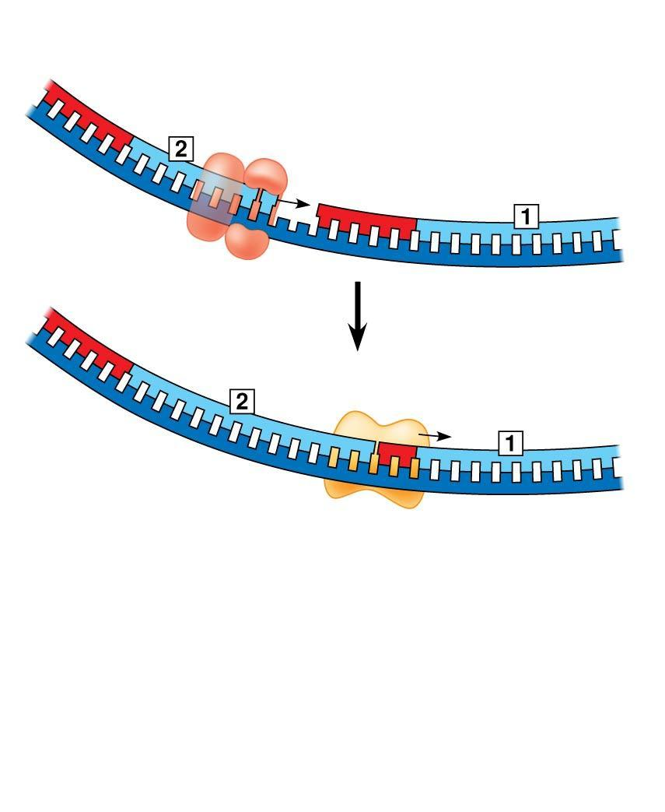
Figure 13.16c-2
RNA primer for fragment 2
5′
Okazaki
fragment 2
3′
4
DNA pol III
makes Okazaki
fragment 2.
3′
5′
5′
3′
5
DNA pol I
replaces RNA
with DNA.
3′
5′
Notes:
*
Figure 13.16c-2 Synthesis of the lagging strand (part 3, step 2)

Slide 73
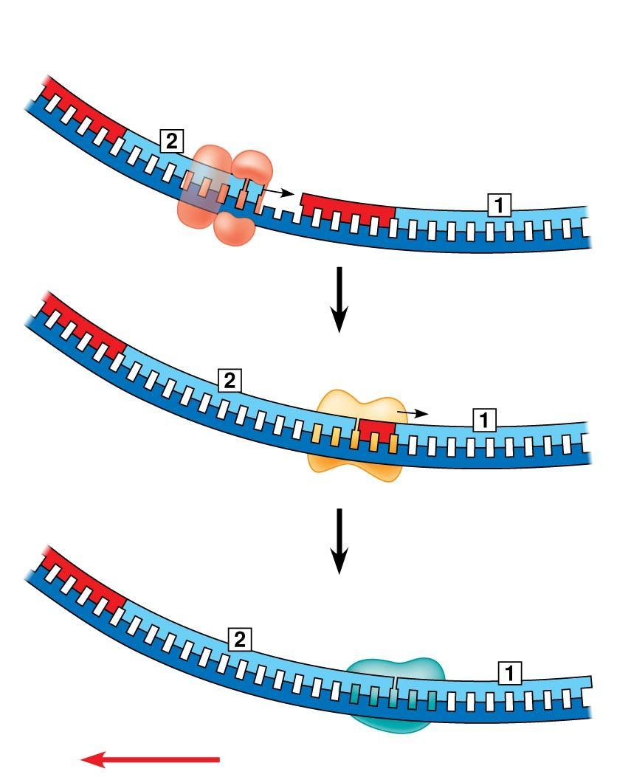
Figure 13.16c-3
RNA primer for fragment 2
5′
Okazaki
fragment 2
3′
4
DNA pol III
makes Okazaki
fragment 2.
3′
5′
5′
3′
5
DNA pol I
replaces RNA
with DNA.
3′
5′
6
DNA ligase forms
bonds between
DNA fragments.
5′
3′
3′
5′
Overall direction of replication
Notes:
*
Figure 13.16c-3 Synthesis of the lagging strand (part 3, step 3)

Slide 74
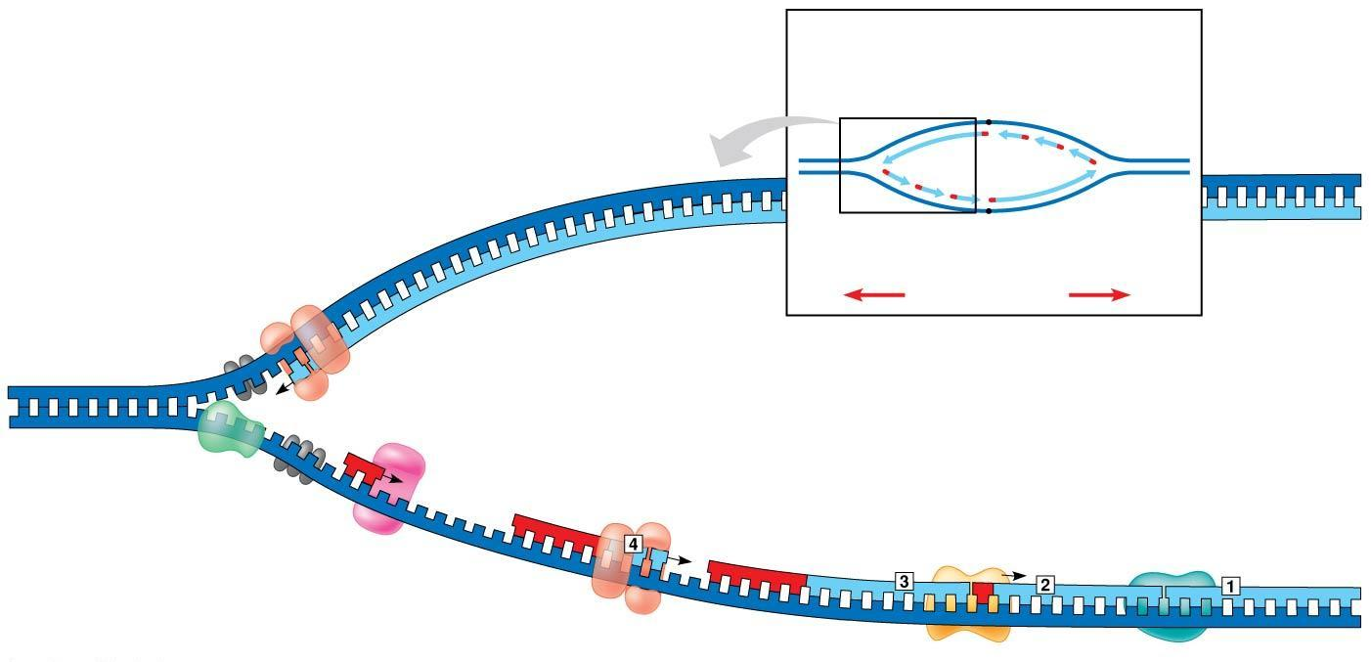
Figure 13.17
Overview
Origin of replication
Leading strand
template
Leading strand
Lagging
strand
Single-strand
binding proteins
Lagging strand
Leading strand
Leading strand
Overall directions
of replication
Helicase
5′
DNA pol III
3′
Primer
3′
5′
Primase
3′
Lagging strand
Parental DNA
DNA pol III
5′
DNA pol I
DNA ligase
Lagging strand
template
3′
5′
3′
5′
Notes:
*
Figure 13.17 A summary of bacterial DNA replication

Slide 75
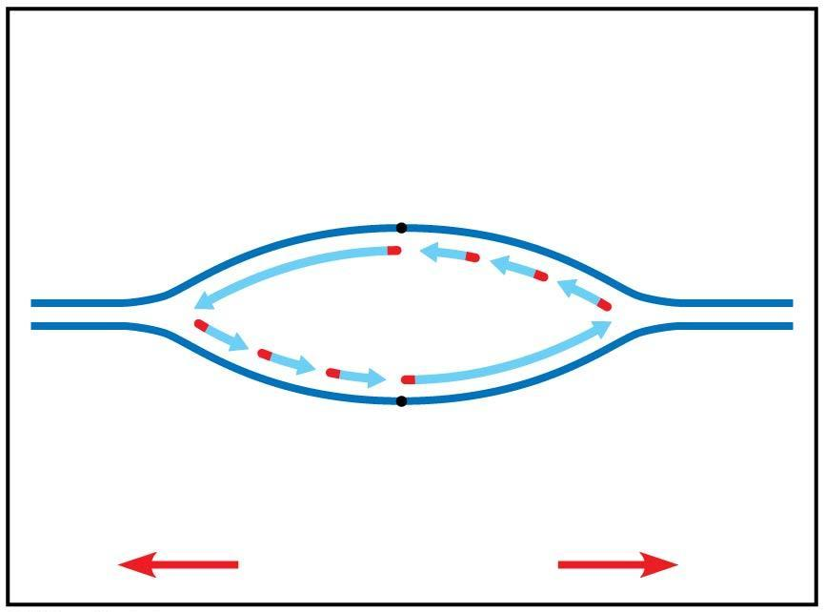
Figure 13.17a
Overview
Origin of replication
Leading strand
Lagging
strand
Lagging strand
Leading strand
Overall directions
of replication
Notes:
*
Figure 13.17a A summary of bacterial DNA replication (part 1)

Slide 76
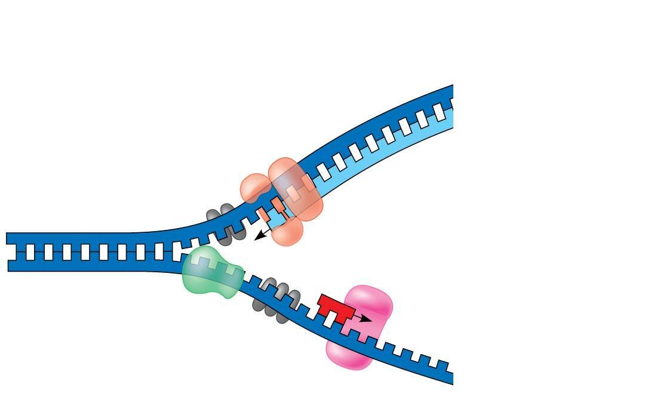
Figure 13.17b
Leading strand
template
Single-strand
binding proteins
Helicase
Leading strand
5′
DNA pol III
3′
Primer
3′
5′
Primase
3′
Parental DNA
Lagging strand
template
Notes:
*
Figure 13.17b A summary of bacterial DNA replication (part 2)

Slide 77
Figure 13.17c
DNA pol III
Lagging strand
5′
3′
DNA pol I
DNA ligase
5′
3′
5′
Notes:
*
Figure 13.17c A summary of bacterial DNA replication (part 3)

Slide 78
The DNA Replication Complex
The proteins that participate in DNA replication form a large complex, a “DNA replication machine”
The DNA replication machine may be stationary during the replication process
Recent studies support a model in which DNA polymerase molecules “reel in” parental DNA and “extrude” newly made daughter DNA molecules
Animation: DNA Replication
Notes:
*

Slide 79
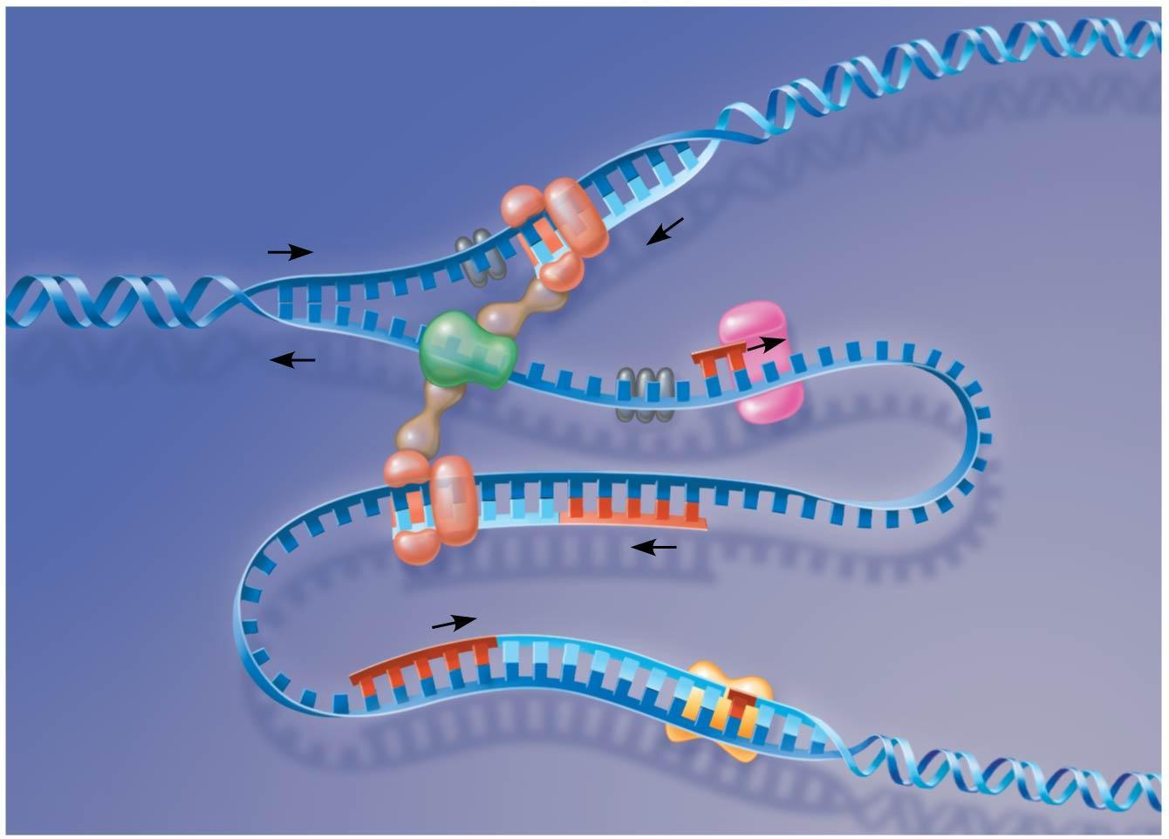
Figure 13.18
DNA pol III
Parental DNA
5′
Leading strand
5′
3′
3′
3′
3′
5′
5′
Connecting
proteins
Helicase
3′
5′
Lagging
strand
template
DNA
pol III
Lagging strand
5′
3′
Notes:
*
Figure 13.18 A current model of the DNA replication complex

Slide 80
Proofreading and Repairing DNA
DNA polymerases proofread newly made DNA, replacing any incorrect nucleotides
In mismatch repair of DNA, other enzymes correct errors in base pairing
A hereditary defect in one such enzyme is associated with a form of colon cancer
This defect allows cancer-causing errors to accumulate in DNA faster than normal
Notes:
*

Slide 81
DNA can be damaged by exposure to harmful chemical or physical agents such as cigarette smoke and X-rays; it can also undergo spontaneous changes
In nucleotide excision repair, a nuclease cuts out and replaces damaged stretches of DNA
Notes:
*

Slide 82
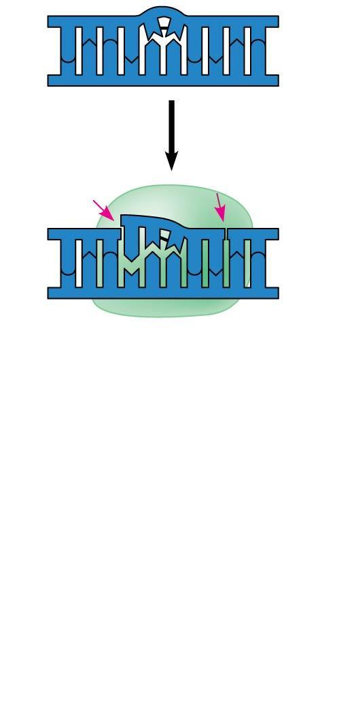
Figure 13.19-1
5′
3′
3′
5′
Nuclease
5′
3′
3′
5′
Notes:
*
Figure 13.19-1 Nucleotide excision repair of DNA damage (step 1)

Slide 83
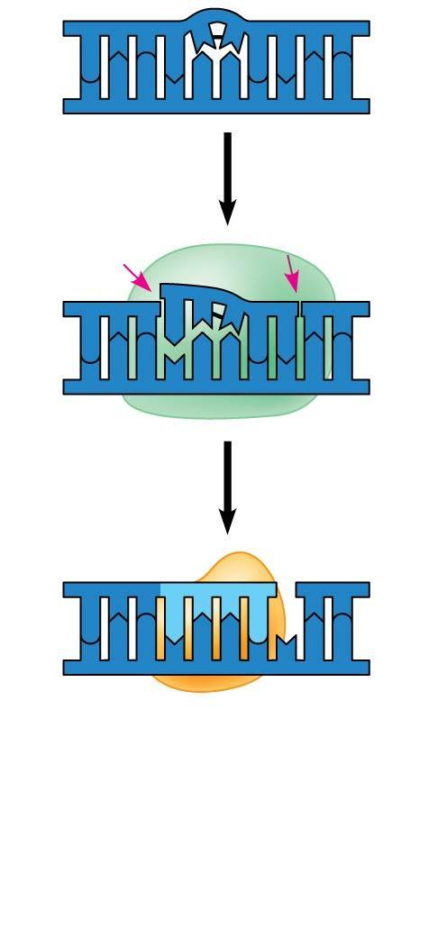
Figure 13.19-2
5′
3′
3′
5′
Nuclease
5′
3′
3′
5′
DNA
polymerase
5′
3′
3′
5′
Notes:
*
Figure 13.19-2 Nucleotide excision repair of DNA damage (step 2)

Slide 84
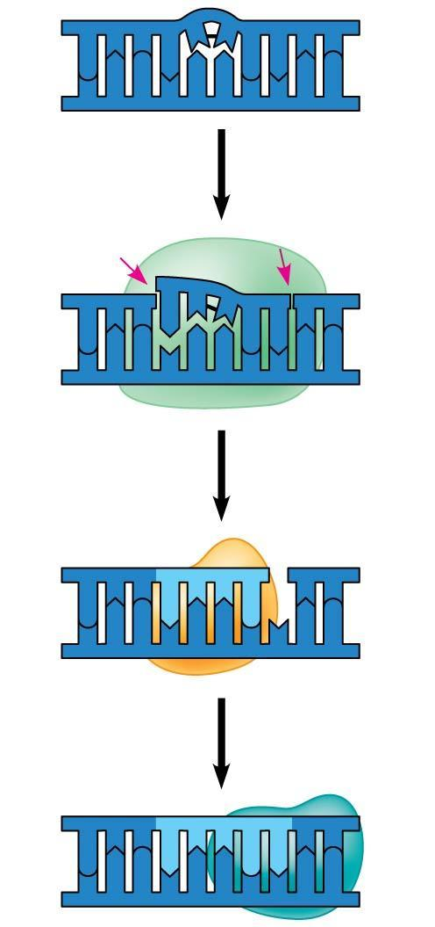
Figure 13.19-3
5′
3′
3′
5′
Nuclease
5′
3′
3′
5′
DNA
polymerase
5′
3′
3′
5′
DNA ligase
5′
3′
3′
5′
Notes:
*
Figure 13.19-3 Nucleotide excision repair of DNA damage (step 3)

Slide 85
Evolutionary Significance of Altered DNA Nucleotides
Error rate after proofreading repair is low but not zero
Sequence changes may become permanent and can be passed on to the next generation
These changes (mutations) are the source of the genetic variation upon which natural selection operates
Notes:
*

Slide 86
Replicating the Ends of DNA Molecules
Limitations of DNA polymerase create problems for the linear DNA of eukaryotic chromosomes
The usual replication machinery cannot complete the 5′ ends of daughter strands
Repeated rounds of replication produce shorter DNA molecules with uneven ends
Animation: DNA Packing
Video: Nucleosome Model
Notes:
*

Slide 87
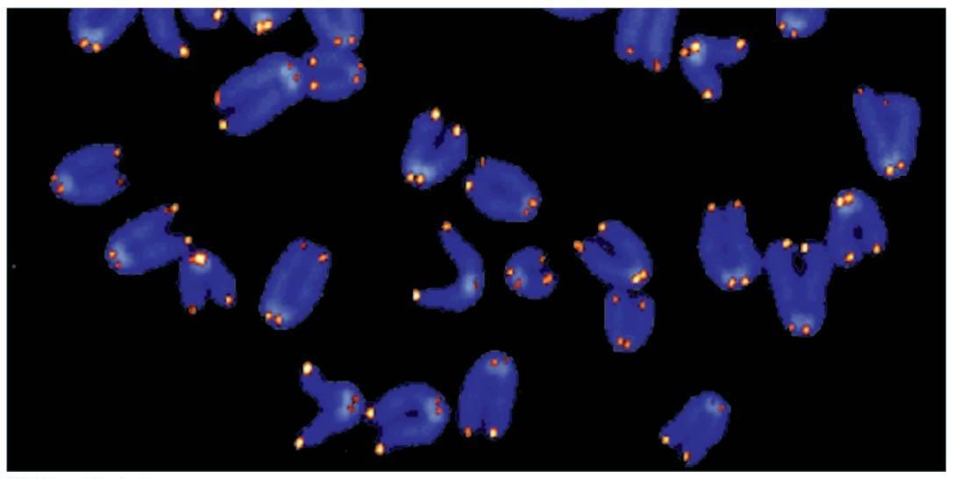
Figure 13.20
1 μm
Notes:
*
Figure 13.20 Telomeres

Slide 88
Eukaryotic chromosomal DNA molecules have special nucleotide sequences at their ends called telomeres
Telomeres do not prevent the shortening of DNA molecules, but they do postpone it
It has been proposed that the shortening of telomeres is connected to aging
Notes:
*

Slide 89
If chromosomes of germ cells became shorter in every cell cycle, essential genes would eventually be missing from the gametes they produce
An enzyme called telomerase catalyzes the lengthening of telomeres in germ cells
Notes:
*

Slide 90
Telomerase is not active in most human somatic cells
However, it does show inappropriate activity in some cancer cells
Telomerase is currently under study as a target for cancer therapies
Notes:
*

Slide 91
Concept 13.3: A chromosome consists of a DNA molecule packed together with proteins
The bacterial chromosome is a double-stranded, circular DNA molecule associated with a small amount of protein
Eukaryotic chromosomes have linear DNA molecules associated with a large amount of protein
In a bacterium, the DNA is “supercoiled” and found in a region of the cell called the nucleoid
Notes:
*

Slide 92
Chromatin, a complex of DNA and protein, is found in the nucleus of eukaryotic cells
Chromosomes fit into the nucleus through an elaborate, multilevel system of packing
Chromatin undergoes striking changes in the degree of packing during the course of the cell cycle
Notes:
*

Slide 93
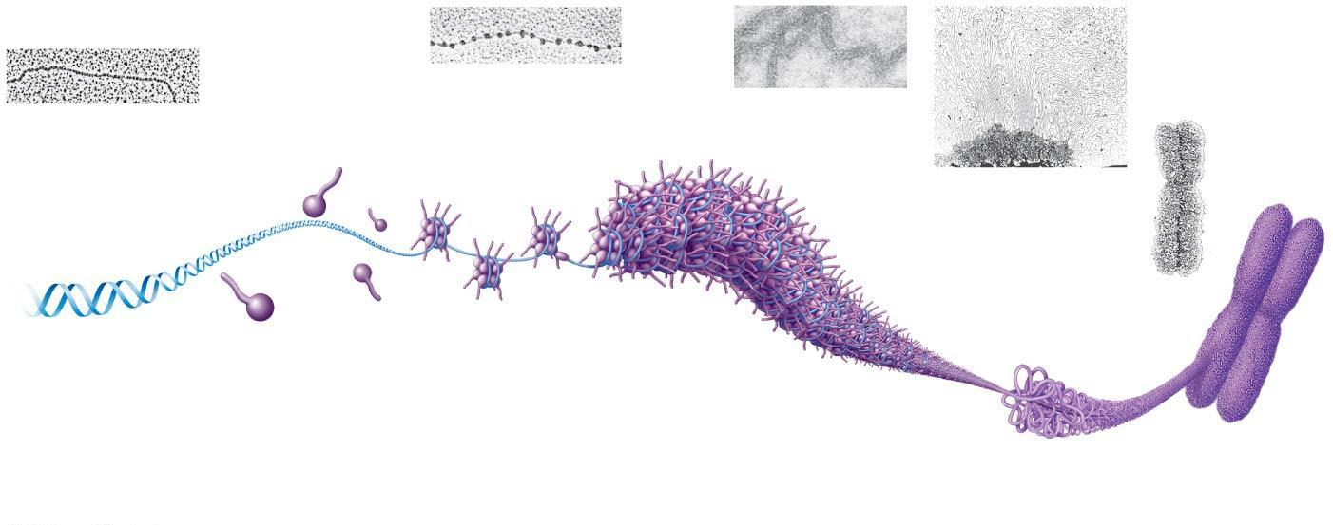
Figure 13.21
Chromatid
(700 nm)
Nucleosome
(10 nm in diameter)
DNA
double helix
(2 nm in diameter)
30-nm
fiber
Loops
Scaffold
H1
300-nm
fiber
Histones
Histone tail
Replicated chromosome
(1,400 nm)
Notes:
*
Figure 13.21 Exploring chromatin packing in a eukaryotic chromosome

Slide 94
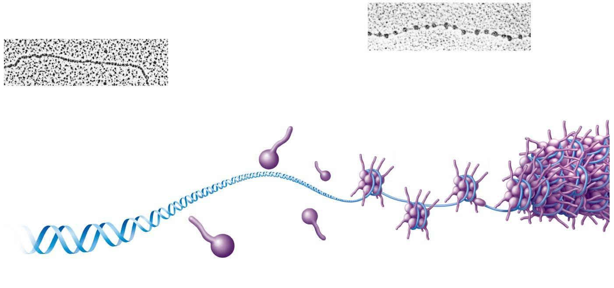
Figure 13.21a
Nucleosome
(10 nm in diameter)
DNA
double helix
(2 nm in diameter)
H1
Histone tail
Histones
Notes:
*
Figure 13.21a Exploring chromatin packing in a eukaryotic chromosome (part 1)

Slide 95
Figure 13.21aa
DNA
double helix
(2 nm in diameter)
Notes:
*
Figure 13.21aa Exploring chromatin packing in a eukaryotic chromosome (part 1a: DNA strand, TEM)

Slide 96
Figure 13.21ab
Nucleosome
(10 nm in diameter)
Notes:
*
Figure 13.21ab Exploring chromatin packing in a eukaryotic chromosome (part 1b: nucleosomes, TEM)

Slide 97
Figure 13.21b
Chromatid
(700 nm)
30-nm
fiber
Loops
Scaffold
300-nm
fiber
Replicated chromosome
(1,400 nm)
Notes:
*
Figure 13.21b Exploring chromatin packing in a eukaryotic chromosome (part 2)

Slide 98
Figure 13.21ba
30-nm fiber
Notes:
*
Figure 13.21ba Exploring chromatin packing in a eukaryotic chromosome (part 2a: 30-nm fiber, TEM)

Slide 99
Figure 13.21bb
Loops
Scaffold
Notes:
*
Figure 13.21bb Exploring chromatin packing in a eukaryotic chromosome (part 2b: looped domains, TEM)

Slide 100
Figure 13.21bc
Chromatid
(700 nm)
Notes:
*
Figure 13.21bc Exploring chromatin packing in a eukaryotic chromosome (part 2c: metaphase chromosome, TEM)

Slide 101
At interphase, most of the chromatin is compacted into a 30-nm fiber, which is folded further in some areas by looping
Even during interphase, centromeres and some other parts of chromosomes are highly condensed, similar to metaphase chromosomes
This condensed chromatin is called heterochromatin; the more dispersed, less compacted chromatin is called euchromatin
Notes:
*

Slide 102
Dense packing of the heterochromatin makes it largely inaccessible to the machinery responsible for transcribing genetic information
Chromosomes are dynamic in structure; a condensed region may be loosened or modified as needed for various cell processes
For example, histones can undergo chemical modifications that result in changes in chromatin organization
Notes:
*

Slide 103
Concept 13.4: Understanding DNA structure and replication makes genetic engineering possible
Complementary base pairing of DNA is the basis for nucleic acid hybridization, the base pairing of one strand of a nucleic acid to another, complementary sequence
Nucleic acid hybridization forms the foundation of virtually every technique used in genetic engineering, the direct manipulation of genes for practical purposes
Notes:
*

Slide 104
DNA Cloning: Making Multiple Copies of a Gene or Other DNA Segment
To work directly with specific genes, scientists prepare well-defined segments of DNA in identical copies, a process called DNA cloning
Most methods for cloning pieces of DNA in the laboratory share general features
Notes:
*

Slide 105
Many bacteria contain plasmids, small circular DNA molecules that replicate separately from the bacterial chromosome
To clone pieces of DNA, researchers first obtain a plasmid and insert DNA from another source (“foreign DNA”) into it
The resulting plasmid is called recombinant DNA
Animation: Restriction Enzymes
Notes:
*

Slide 106
Figure 13.22
Bacterium
Cell containing gene
of interest
1
Gene inserted
into plasmid
Bacterial
chromosome
Plasmid
DNA of chromosome
(“foreign” DNA)
Recombinant
DNA (plasmid)
Gene of interest
2
Plasmid put into
bacterial cell
Recombinant
bacterium
3
Host cell grown in culture to form a clone of
cells containing the “cloned” gene of interest
Gene of
interest
Protein expressed
from gene of interest
Copies of gene
Protein harvested
4
Basic
research
and various
applications
Gene for pest resistance
inserted into plants
Human growth hormone
treats stunted growth
Gene used to alter bacteria
for cleaning up toxic waste
Protein dissolves blood clots
in heart attack therapy
Notes:
*
Figure 13.22 An overview of gene cloning and some uses of cloned genes

Slide 107
Figure 13.22a
Cell containing
gene of interest
Bacterium
1
Gene inserted
into plasmid
Bacterial
chromosome
Plasmid
DNA of
chromosome
(“foreign” DNA)
Recombinant
DNA (plasmid)
Gene of interest
2
Plasmid put into
bacterial cell
Recombinant
bacterium
3
Host cell grown in culture to
form a clone of cells containing
the “cloned” gene of interest
Gene of
interest
Protein expressed
from gene of interest
Notes:
*
Figure 13.22a An overview of gene cloning and some uses of cloned genes (part 1: steps)

Slide 108
Figure 13.22b
Gene of
interest
Protein expressed
from gene of interest
Copies of gene
Protein harvested
4
Basic
research
and various
applications
Gene for pest resistance
inserted into plants
Human growth hormone
treats stunted growth
Gene used to alter bacteria
for cleaning up toxic waste
Protein dissolves blood clots
in heart attack therapy
Notes:
*
Figure 13.22b An overview of gene cloning and some uses of cloned genes (part 2: applications)

Slide 109
The production of multiple copies of a single gene is called gene cloning
Gene cloning is useful to make many copies of a gene and to produce a protein product
The ability to amplify many copies of a gene is crucial for applications involving a single gene
Notes:
*

Slide 110
Using Restriction Enzymes to Make Recombinant DNA
Bacterial restriction enzymes cut DNA molecules at specific DNA sequences called restriction sites
A restriction enzyme usually makes many cuts, yielding restriction fragments
Notes:
*

Slide 111
Figure 13.23-1
Restriction site
5′
3′
DNA
G
A
A
T
T
C
C
T
T
A
A
G
3′
5′
1
Restriction enzyme cuts
the sugar-phosphate
backbones.
3′
5′
3′
5′
G
A
A
T
T
C
C
T
T
A
A
G
5′
3′
3′
Sticky end
5′
Notes:
*
Figure 13.23-1 Using a restriction enzyme and DNA ligase to make recombinant DNA (step 1)

Slide 112
Figure 13.23-2
Restriction site
5′
3′
DNA
G
A
A
T
T
C
C
T
T
A
A
G
3′
5′
1
Restriction enzyme cuts
the sugar-phosphate
backbones.
5′
3′
5′
3′
5′
G
A
A
T
T
C
C
T
T
A
A
G
5′
3′
3′
Sticky end
5′
5′
2
DNA fragment added
from another molecule
cut by same enzyme.
Base pairing occurs.
A
A
T
T
C
3′
G
3′
5′
5′
3′
5′
3′
5′
3′
G
A
A
T
T
C
G
A
A
T
T
C
C
T
T
A
A
G
C
T
T
A
A
G
3′
5′
3′
5′
3′
5′
One possible combination
Notes:
*
Figure 13.23-2 Using a restriction enzyme and DNA ligase to make recombinant DNA (step 2)

Slide 113
Figure 13.23-3
Restriction site
5′
3′
DNA
G
A
A
T
T
C
C
T
T
A
A
G
3′
5′
1
Restriction enzyme cuts
the sugar-phosphate
backbones.
3′
5′
3′
5′
G
A
A
T
T
C
C
T
T
A
A
G
5′
3′
3′
Sticky end
5′
5′
2
DNA fragment added
from another molecule
cut by same enzyme.
Base pairing occurs.
A
A
T
T
C
3′
G
3′
5′
5′
3′
5′
3′
5′
3′
G
A
A
T
T
C
G
A
A
T
T
C
C
T
T
A
A
G
C
T
T
A
A
G
3′
5′
3′
5′
3′
5′
3
DNA ligase
seals the strands.
One possible combination
5′
3′
3′
Recombinant DNA molecule
5′
Notes:
*
Figure 13.23-3 Using a restriction enzyme and DNA ligase to make recombinant DNA (step 3)

Slide 114
To see the fragments produced by cutting DNA molecules with restriction enzymes, researchers use gel electrophoresis
This technique separates a mixture of nucleic acid fragments based on length
Notes:
*

Slide 115
Figure 13.24
Mixture of
DNA mol-
ecules of
different
sizes
Power
source
Cathode
Anode
Wells
Gel
(a) Negatively charged DNA molecules will move
toward the positive electrode.
Restriction fragments
(b) Shorter molecules are impeded less than
longer ones, so they move faster through the gel.
Notes:
*
Figure 13.24 Gel electrophoresis

Slide 116
Figure 13.24a
Mixture of
DNA mol-
ecules of
different
sizes
Power
source
Cathode
Anode
Wells
Gel
(a) Negatively charged DNA molecules will move
toward the positive electrode.
Notes:
*
Figure 13.24a Gel electrophoresis (part 1: art)

Slide 117
Figure 13.24b
Restriction fragments
(b) Shorter molecules are impeded less than
longer ones, so they move faster through the gel.
Notes:
*
Figure 13.24b Gel electrophoresis (part 2: photo)

Slide 118
The most useful restriction enzymes cleave the DNA in a staggered manner to produce sticky ends
Sticky ends can bond with complementary sticky ends of other fragments
DNA ligase can close the sugar-phosphate backbones of DNA strands
Notes:
*

Slide 119
In gene cloning, the original plasmid is called a cloning vector
A cloning vector is a DNA molecule that can carry foreign DNA into a host cell and replicate there
Notes:
*

Slide 120
Amplifying DNA in Vitro: The Polymerase Chain Reaction (PCR) and Its Use in Cloning
The polymerase chain reaction, PCR, can produce many copies of a specific target segment of DNA
A three-step cycle brings about a chain reaction that produces an exponentially growing population of identical DNA molecules
The key to PCR is an unusual, heat-stable DNA polymerase called Taq polymerase.
Notes:
*

Slide 121
Figure 13.25
Technique
5′
3′
Target sequence
Genomic DNA
3′
5′
1
Denaturation
5′
3′
3′
5′
2
Annealing
Cycle 1
yields 2 molecules
Primers
3
Extension
New
nucleotides
Cycle 2
yields 4 molecules
Cycle 3
yields 8 molecules;
2 molecules
(in white boxes)
match target sequence
Notes:
*
Figure 13.25 Research method: the polymerase chain reaction (PCR)

Slide 122
Figure 13.25a
5′
3′
Target sequence
Genomic DNA
3′
5′
Notes:
*
Figure 13.25a Research method: the polymerase chain reaction (PCR) (part 1)

Slide 123
Figure 13.25b-1
1
Denaturation
5′
3′
3′
5′
Cycle 1
yields 2
molecules
Notes:
*
Figure 13.25b-1 Research method: the polymerase chain reaction (PCR) (part 2, step 1)

Slide 124
Figure 13.25b-2
1
Denaturation
5′
3′
3′
5′
2
Annealing
Cycle 1
yields 2
molecules
Primers
Notes:
*
Figure 13.25b-2 Research method: the polymerase chain reaction (PCR) (part 2, step 2)

Slide 125
Figure 13.25b-3
1
Denaturation
5′
3′
3′
5′
2
Annealing
Cycle 1
yields 2
molecules
Primers
3
Extension
New
nucleotides
Notes:
*
Figure 13.25b-3 Research method: the polymerase chain reaction (PCR) (part 2, step 3)

Slide 126
Figure 13.25c
Cycle 2
yields 4 molecules
Cycle 3
yields 8 molecules;
2 molecules
(in white boxes)
match target sequence
Results
After 30 more cycles, over 1 billion (10⁹) molecules
match the target sequence.
Notes:
*
Figure 13.25c Research method: the polymerase chain reaction (PCR) (part 3)

Slide 127
PCR amplification alone cannot substitute for gene cloning in cells
Instead, PCR is used to provide the specific DNA fragment to be cloned
PCR primers are synthesized to include a restriction site that matches the site in the cloning vector
The fragment and vector are cut and ligated together
Notes:
*

Slide 128
Figure 13.26
Cloning
vector
(bacterial
plasmid)
DNA fragment obtained by
PCR (cut by same restriction
enzyme used on cloning vector)
Mix and ligate
Recombinant DNA plasmid
Notes:
*
Figure 13.26 Use of restriction enzymes and PCR in gene cloning

Slide 129
DNA Sequencing
Once a gene is cloned, complementary base pairing can be exploited to determine the gene’s complete nucleotide sequence
This process is called DNA sequencing
Notes:
*

Slide 130
“Next-generation” sequencing techniques, developed in the last ten years, are rapid and inexpensive
They sequence by synthesizing the complementary strand of a single, immobilized template strand
A chemical trick enables electronic monitors to identify which nucleotide is being added at each step.
Notes:
*

Slide 131
Figure 13.UN01
Notes:
*
Figure 13.UN01 Skills exercise: working with data in a table

Slide 132
Figure 13.UN03
G
C
A
T
T
A
Nitrogenous
bases
Sugar-phosphate
backbone
G
C
C
G
A
T
C
G
Hydrogen bond
T
A
Notes:
*
Figure 13.UN03 Summary of key concepts: double helix

Slide 133
Figure 13.UN04
DNA pol III synthesizes
leading strand continuously
3′
5′
Parental
DNA
DNA pol III starts DNA
synthesis at 3′ end of primer
continues in 5′ → 3′ direction
Origin of
replication
5′
3′
5′
Lagging strand synthesized
in short Okazaki fragments,
later joined by DNA ligase
Helicase
Primase synthesizes
a short RNA primer
3′
5′
DNA pol I replaces the RNA
primer with DNA nucleotides
Notes:
*
Figure 13.UN04 Summary of key concepts: DNA replication

Slide 134
Figure 13.UN05
5′
3′
5′
3′
G
A
A
T
T
C
C
T
T
A
A
G
3′
5′
3′
5′
Sticky end
Notes:
*
Figure 13.UN05 Summary of key concepts: restriction fragments

Slide 135
Figure 13.UN06
Notes:
*
Figure 13.UN06 Test your understanding, question 11 (DNA replication complex)

