Slide 1
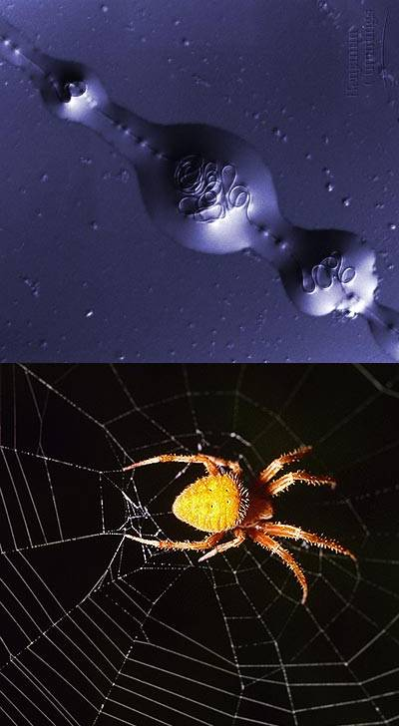
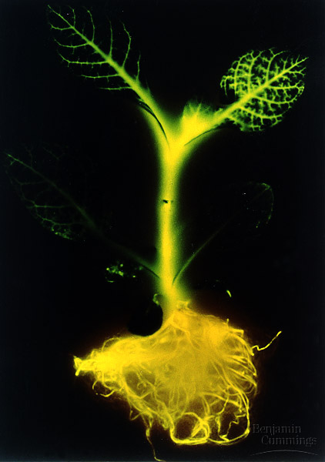
Protein Synthesis

Slide 2
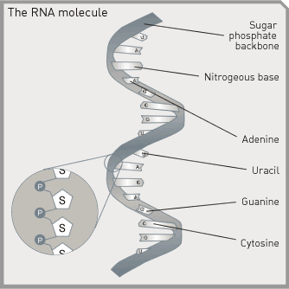
RNA
Single strand of nucleotides
Contains uracil instead of thymine
Made of the 5-Carbon sugar Ribose instead of deoxyribose (DNA)
http://www.makingthemodernworld.org.uk/learning_modules/biology/01.TU.03/illustrations/01.IL.09.gif

Slide 3
Difference between DNA and RNA
DNA | RNA
5-Carbon Sugar: deoxyribose | 5-Carbon sugar: Ribose
A,T,C,G | A,U,C,G
Double stranded | Single stranded

Slide 4
3 Types of RNA
mRNA: messenger RNA
tRNA: transfer RNA
rRNA: ribosomal RNA

Slide 5
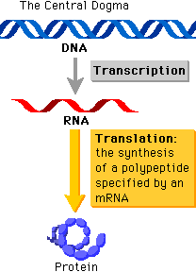
Main Idea
Transcription
Translation
DNA
RNA
protein

Slide 6
http://fajerpc.magnet.fsu.edu/Education/2010/Lectures/26_DNA_Transcription_files/image006.jpg

Slide 7
Transcription
Molecule of DNA is copied into a complimentary mRNA strand
http://fig.cox.miami.edu/~cmallery/150/gene/c7.17.7b.transcription.jpg

Slide 8
RNA Polymerase
RNA polymerase is an enzyme
Attaches to special places on the DNA
Unzips the two strands of DNA
Synthesizes the mRNA strand
https://publicaffairs.llnl.gov/news/news_releases/2005/images/RNA_polymerase309x283.jpg

Slide 9
Steps of Transcription
Step 1: RNA polymerase attaches to DNA
Step 2: RNA polymerase unzips DNA
Step 3: RNA polymerase hooks together the nucleotides as they base-pair along the DNA template
Step 4: Completed mRNA strand leaves the nucleus
Transcription video

Slide 10
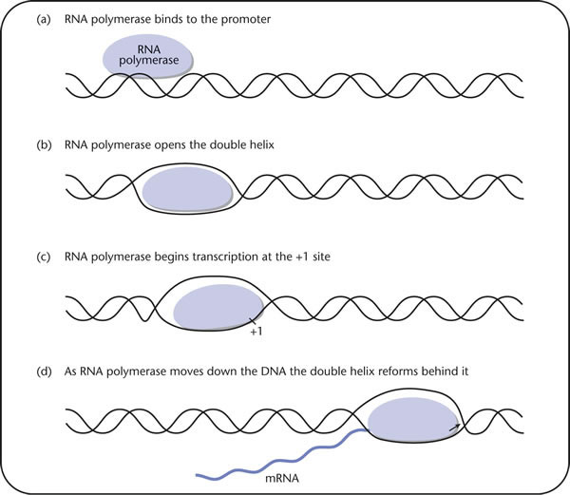
Transcription
http://www.blackwellpublishing.com/Microbiology/images/12-04.jpg

Slide 11
Translation
Ribosomes use mRNA as a guide to make proteins
http://fajerpc.magnet.fsu.edu/Education/2010/Lectures/26_DNA_Transcription_files/image006.jpg

Slide 12
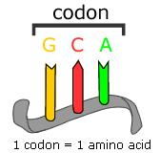
The message
mRNA is a strand of nucleotides
  Ex. AUGCCGUUGCCA…
Each combination of three nucleotides on the mRNA is called a codon

Slide 13
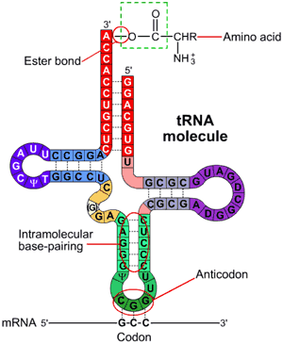
tRNA
Transfer RNA
Single strand of RNA that loops back on itself
Has an Amino Acid attached at one end
  Amino Acids are the building blocks of proteins
Has an anticodon at the other end
http://www.wiley.com/legacy/college/boyer/0470003790/structure/tRNA/trna_diagram.gif

Slide 14
What is an anticodon?
The anticodon is a set of three nucleotides on the tRNA that are complimentary to the codon on the mRNA
tRNA
http://www.wiley.com/legacy/college/boyer/0470003790/structure/tRNA/trna_diagram.gif

Slide 15
Steps of Translation
Step 1: mRNA binds to ribosome
Step 2: tRNA anticodon attaches to the first mRNA codon
Step 3: the anticodon of another tRNA binds to the next mRNA codon
Step 4: A peptide bond is formed between the amino acids the tRNA molecules are carrying.
video

Slide 16
Steps of Translation cont.
Step 5: After the peptide bond is formed, the first tRNA leaves. The ribosome moves down to the next codon.
Step 6: This process continues until the ribosome reaches a stop codon.
Step 7: The chain of peptides (protein) is released and the mRNA and ribosome come apart.
video

Slide 17
Translation

Slide 18
Translation
http://www.medicine.uottawa.ca/Pathology/devel/images/text_figure8.gif

Slide 19
Amino Acids
There are 20 different Amino Acids
Chains of amino acids are connected by peptide bonds and called polypeptides or proteins
Codons code for different amino acids
  In order to code for twenty amino acids, more than one nucleotide has to be part of the code

Slide 20
The Genetic Code
http://www.cbs.dtu.dk/staff/dave/roanoke/fig13_18.jpg

Slide 21
What happens if DNA is not copied correctly?
MUTATIONS!!!!!
  Changes in the genetic information of the cell

Slide 22
Mutations
Single Base Mutations Insertions and Deletions
Missense
or NonsenseMutations
Silent
Mutation

Slide 23
Missense Mutations:
A nucleotide substitution changes the codon
-Ex. Sickle Cell Disease

Slide 24

Sickle Cell Disease
Red blood cells become sickle-shaped and have difficulty passing through small blood vessels and less blood can reach parts of the body causing damage.
Normal
Sickle

Slide 25
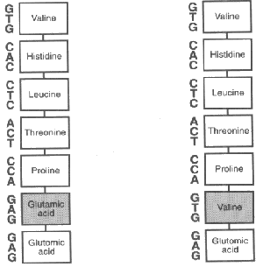
Sickle Cell Missense Mutation
A instead of T in the gene for
hemoglobin changes the
codon GAG (for glutamic
acid) to GTG (which encodes
valine). So the amino acid in
the chain becomes valine
instead of glutamic acid

Slide 26
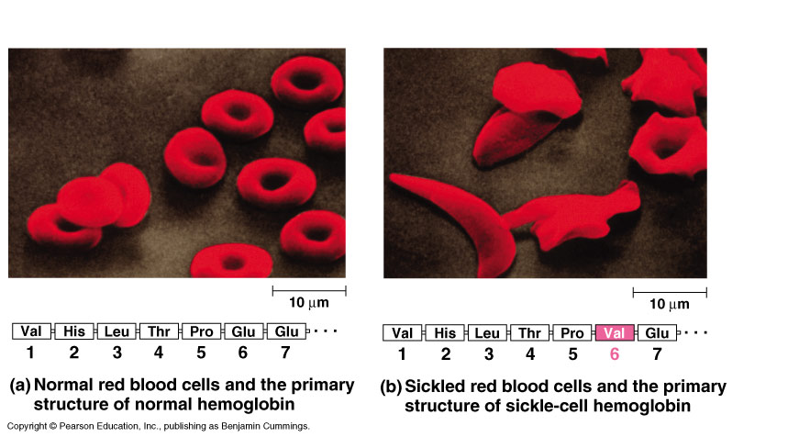
Fig. 5.19
Copyright © 2002 Pearson Education, Inc., publishing as Benjamin Cummings

Slide 27
Nonsense Mutations
A nucleotide substitution changes the codon to a stop codon
Production of protein stops prematurely
  Ex. Cystic Fibrosis

Slide 28
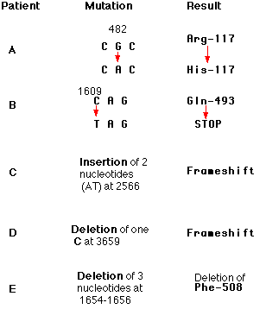
Cystic Fibrosis
the substitution of a T for a C at nucleotide 1609 converted a glutamine codon (CAG) to a STOP codon (TAG).
protein had only the first 493 amino acids of the normal chain of 1480 and could not function
no single mutation is responsible for all cases of cystic fibrosis

Slide 29
Silent Mutations
Called silent because the nucleotide substitution does not change the amino acid.
Most amino acids are encoded by several different codons
Serine

Slide 30
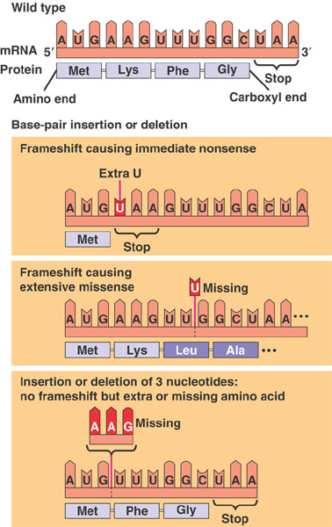
Insertions and deletions
Extra base pairs may be added (insertions) or removed (deletions) from the DNA
Results in a frameshift
Ex. Huntington’s Disease

Slide 31
Huntington’s disease
Breaking down of brain cells in certain areas of the brain, causing uncontrolled movements, loss of intellectual faculties, and emotional disturbance.
It is a genetic disease, passed from parent to child through a mutation in the normal gene.

Slide 32
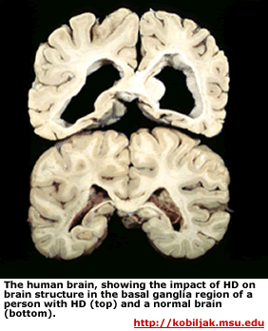
Huntington’s Mutation
Insertion of repeating CAGs, which adds a string of glutamines (Gln) to the protein.
The modified protein increases level of p53
Triggers apoptosis (cell death)

